Slide 1

MODULE 2 SLIDES:
Identifying Workforce Needs
XXXXX County/Region
Mark C. White, Ph.D.
Clinical Associate Professor
Department of Agricultural and Consumer Economics
University of Illinois, Urbana-Champaign

Slide 2
This project supports efforts to build rural communities’ capacity to address workforce challenges
This effort seeks to create a rural workforce engagement model for Cooperative Extension:
  Funded by the Ascendium Education Group
  Managed by the Association of Public & Land-Grant Universities (APLU) and the
  North Central Regional Center for Rural Development (NCRDRC) at Purdue University.
This element of the project provides a resource to help build data literacy in order to inform & ground community workforce efforts.

Slide 3
About these resources
The material presented here supplements the information presented in the written guide.
  Much of the underlying data for the sample charts included below are available in the associated Excel workbook.
  The section numbers are used to connect the materials in the guide, PPT, and Excel workbook.
Throughout, the resources highlighted in all the materials focus primarily on tools and resources that are freely available to the public.
Notes:
The written guide contains more detailed descriptions of each data element—where they come from, why they matter, the questions they can help answer, and how to use the data properly. This PPT is meant to be used in concert with that guide.
We have also developed an Excel file containing the actual data and the associated charts. This Excel file includes examples from regions across the nation, and users can use this file as a resource for pulling together data and charts for their own region.
The section numbers used in the written guide, PPT, and Excel workbook are consistent so as to connect the materials throughout.

Slide 4
ABOUT LABOR MARKET INFORMATION

Slide 5
LMI – Workforce Information
The body of information that deals with the functioning of labor markets and the determination of the demand for, and supply of, labor.
Includes but not limited to information on:
  The number of people employed or unemployed,
  Unemployment rates,
  Average wages and income,
  Population and demographics characteristics
  Employment projections
  Other economic variables.

Slide 6
Main Suppliers of Labor Market Information
U.S. Bureau of Labor Statistics (DoL)
State LMI Agencies
U.S. Census Bureau
U.S. Bureau of Economic Analysis
Private Sources and Proprietary Data Vendors
National Programs
Employment and Training Administration (DoL)
Workforce Information Grant
Program Administrative Data
O*NET
“Counts the Jobs”
“Counts the People” (among many other things)
US Commerce Dept.
“Counts the Money”
US Commerce Dept.
Data Aggregators
Economic Modelers
‘Real-Time LMI”
Federal/State Cooperative Programs
Notes:
There are many sources of LMI. We have elected to focus primarily on publicly available data, as it is less expensive and often free.
It is important to note that these agencies have different programs, and as a result produce a variety data products (e.g., the Census Bureau does more than the Decennial Census and/or American Community Survey).
We do not spend time showing people how to use the different data tools and websites, as many are relatively straight-forward. Also, these websites and tools do change over the years as the providers attempt to improve their sites.

Slide 7
Different LMI User groups
Students and jobseekers use data to find and select career and job opportunities;
Employers use LMI to understand local prevailing wages for a given occupation;
Counselors need information to place students and workers in jobs and careers;
Education and training providers use LMI to help determine the courses and programs they offer, and
Community leaders use LMI to inform workforce training and economic development investment decisions.
Notes:
‘Know your audience’ is a key mantra, and it is important to recognize that the types of data you will need will vary depending on what type of group with who you are working and/or speaking.

Slide 8
This information helps us answer many common questions, including…
What industries drive my economy?
What does my workforce look like, and what can they do?
What kind of workers do my employers need now, and in the future?
What types of policies and investments should my community, region, state make to grow the workforce?
What do I need to know to select a career or find a job?
Notes:
Each of the aforementioned groups will want different questions answered.
As an organizer of a community workforce initiative, you will need to understand a variety of workforce issues in your community. There is no one data source that can help you answer all those questions, so you will need to use several.

Slide 9
Data User Perspective:
Characteristics of “Good Data”
Accurate
Current
Detailed Variables
and Geography
Accessible
How do different users define each?
The data users’ “sweet spot”
Notes:
From a data user’s perspective we want our data to be accurate, timely, cover our respective geography/service area, as well as being easy to access.
Not all data sources meet all these needs. So you will need to know how to work with the data you have, rather than the data you want. One of the key things you will need to understand then is what your data actually say, and importantly what they don’t say.

Slide 10
ASSEMBLING THE INFORMATION NECESSARY TO SUPPORT CAREER PATHWAYS INITIATIVES
Notes:
We don’t prepare data and information in a vacuum. It is done with a purpose. This section lays out the steps for preparing information in support of your regional or community workforce initiative.
This material is covered in greater detail in the ‘Assembling information to support community workforce initiatives’ section of the written guide.

Slide 11
Developing the necessary information requires several steps
Understand the priorities of community leaders
Develop research plan that speaks to those priorities
Consider how the information can help build support
Set the direction
Examine key issues and focus areas
Frame data for different audiences
Validate data
Determine strategic focus
  Target industry (e.g., construction) or occupational (e.g., IT) focus
  Specific populations (e.g., Youth, disabled, etc.)
Customize information according to participant needs
  Stakeholders: Emphasis on labor market conditions
  Jobseekers: Focus on employment opportunities & career exploration
Build in multiple feedback opportunities for stakeholders (e.g., employers, instructors)
Use feedback to identify critical information & remaining information gaps.
Notes:
The best place to start is to understand the priorities of your community leaders.
If you understand those priorities, you can prepare information that reflects and meets their needs.
If they do not have any stated priorities, the research can help identify challenges or opportunities, upon which they may want to focus.
Throughout the research and information can be used as a tool or an avenue for generating or building support for your initiative.
Its not enough to say this is important and you should support; its better to be able to say you should support this and I can show you (with actual data) why this is important and requires your support.

Slide 12
Your efforts will garner more support if they align with how the community prioritizes jobs.
Good paying jobs: Look at jobs that pay above the median wage, or a family-sustaining wage.
Middle-skill jobs: Emphasize jobs that require more than high school, less than a 4-year degree, and some OJT.
Pathway jobs: Identify jobs that, with incremental education & training, can provide steppingstones to other higher-paying jobs.
High demand jobs: Focus on jobs that have grown and are projected to grow.
Cross-cutting occupations: Select occupations that are in-demand across multiple industries.
Uniquely competitive occupations: Examine occupations that are relatively concentrated in your region (using LQs).
Diversity and Inclusion: Consider jobs that employ people of different age, gender, race and ethnicity.
Notes:
Community priorities vary, and as a result the type of information you need to address these priorities will also vary.
In short, different issues require different types of data.

Slide 13
Developing the necessary information requires several steps
Set the direction
Examine key issues and focus areas
Frame data for different audiences
Validate data
Understand the priorities of community leaders
Develop research plan that speaks to those priorities
Consider how the information can help build support
Determine strategic focus
  Target industry (e.g., construction) or occupational (e.g., IT) focus
  Specific populations (e.g., Youth, disabled, etc.)
Customize information according to participant needs
  Stakeholders: Emphasis on labor market conditions
  Jobseekers: Focus on employment opportunities & career exploration
Build in multiple feedback opportunities for stakeholders (e.g., employers, instructors)
Use feedback to identify critical information and remaining information gaps.
Notes:
Once you have identified your priorities, you can shape your strategic focus. The data you need for your subsequent research will reflect these priorities and focus.

Slide 14
Target Industry Focus (e.g., MFG, Construction)
Key information includes:
  Industry activities, size and scale (Section 3a),
  Industry demographics (Section 3b),
  Industry staffing patterns (Section 4b)
    Identify prominent occupations
    Occupational requirements (Section 4d)
Employer input (Section 6a) will be necessary to better understand unique local needs as well as to help identify any mission critical occupations.

Slide 15
Selected occupations or fields (e.g., IT, Maintenance)
Key information includes:
  Regional demand and wages (Section 4a)
  Information about occupational requirements (Section 4d)
  Reverse staffing patterns show which industries and employers are most likely to employ these types of workers (Section 4b)
  Local education and training providers (Section 5a) are sources of potential workers and incumbent worker training.
Employer input (Section 6a) will be necessary to identify training needs and describe potential career pathway opportunities.

Slide 16
Specific populations (e.g., disadvantaged, underrepresented, disabled or youth workers)
Key information includes:
  The size of the group and how and in what ways are they currently participating in the local labor force (Section 1c to 1g)
  Industry demographics (Section 3b) can help identify where different types of workers—be they of a specific age demographic, gender, or race and ethnicity— are currently working and where they might be underrepresented
Employer and stakeholder input (Section 6a) will be necessary to identify challenges and opportunities facing these populations, as well as where efforts must be made to address these challenges

Slide 17
Developing the necessary information requires several steps
Understand the priorities of community leaders
Develop research plan that speaks to those priorities
Consider how the information can help build support
Set the direction
Examine key issues and focus areas
Frame data for different audiences
Validate data
Determine strategic focus
  Target industry (e.g., construction) or occupational (e.g., IT) focus
  Specific populations (e.g., Youth, disabled, etc.)
Customize information according to participant needs
  Stakeholders: Emphasis on labor market conditions
  Jobseekers: Focus on employment opportunities & career exploration
Build in multiple feedback opportunities for stakeholders (e.g., employers, instructors)
Use feedback to identify critical information and remaining information gaps.
Notes:
Just as your data and research will need to vary based on your focus area, so too will it need to vary based upon the needs and interests of your audience and participants.

Slide 18
This guide serves an array of potential users.
Some users focus on the general labor market, while others need job-specific information.
Notes:
Not every participant will need every piece of information.
The written guide is intended to serve as a resource for an array of users. Among most common user groups only extension educators (presumably leading the broader project efforts) and workforce and/or economic development professionals might need to familiarize themselves with all the data elements described in the guide.
Other participants will only need some of the information presented, such as understanding occupation demand and how well area post-secondary institutions can meet those needs.

Slide 19
Building career pathways programs requires an array of participants and they each have different information needs.
Stakeholders
  e.g., community leaders, ED/WF professionals, extension educators, etc.
  Need wider array of LMI that address both labor supply and demand
  Used to highlight workforce challenges, or to build support (financial or otherwise) for workforce strategies.
Jobseekers
  e.g., students, incumbent or displaced workers
  Need more targeted information that guides their career exploration or job search
  Concise information to answer straight forward questions (e.g., How much should I expect to make in this job?)
Notes:
These distinctions are equally as important for broader community workforce initiatives or more focused efforts to, for instance, build career pathways programs.
Understanding these differences are critical for securing and maintaining participation.

Slide 20
Developing the necessary information requires several steps
Set the direction
Examine key issues and focus areas
Frame data for different audiences
Validate data
Understand the priorities of community leaders
Develop research plan that speaks to those priorities
Consider how the information can help build support
Determine strategic focus
  Target industry (e.g., construction) or occupational (e.g., IT) focus
  Specific populations (e.g., Youth, disabled, etc.)
Customize information according to participant needs
  Stakeholders: Emphasis on labor market conditions
  Jobseekers: Focus on employment opportunities & career exploration
Build in multiple feedback opportunities for stakeholders (e.g., employers, instructors)
Use feedback to identify critical information and remaining information gaps.
Notes:
It is important to note that the research process is not a one-time activity. Ideally it would be an ongoing activity that allows for multiple feedback loops.
This ongoing research can be used to track outcomes, strengthen programs, address new challenges and focus areas as they arise, identify issues requiring additional research, etc.

Slide 21
Validating this information with employers or other key stakeholders will strengthen your efforts
Qualitative data can help interpret your findings
  Quantitative data shows patterns, qualitative helps explain underlying processes.
These conversations can add important or missing details to your understanding of workforce issues and challenges.
Specific examples can also make your story more compelling, by ‘putting a face on data’.
Engaging stakeholders and private sector leaders in your research can help build support for your subsequent efforts.
Creating feedback loops on what works or does not work—in the past, present and future—can strengthen the effectiveness of your strategies.
Notes:
Stakeholder engagement should also be built into the research process. These stakeholders can help interpret, explain, or validate the findings of the research.
This additional feedback can ground truth your data and strengthen your research, which in turn can help you build credibility and confidence in the research findings.
You can then use this information to more effectively communicate your findings, which can build credibility and confidence in you the researcher. This can you deliver your message more effectively.

Slide 22
This guide can support community or regional workforce initiatives by:
Directing users toward data tools and resources that will allow them to answer key labor market questions.
Describing how these data are produced and what they show.
Identifying any important caveats for which users must be aware when using these data.
Notes:
Our goal with these materials is to help build your capacity to find the information you need to answer key questions.
It is also intended to improve your data literacy so you can accurate state what these data are saying, and what they are not saying.

Slide 23
UNDERSTANDING LABOR SUPPLY
Notes:
This section will cover issues of labor supply. This largely includes basic demographic trends (Section 1) that shape the availability of workers, as well as labor trends and characteristics (section 2).

Slide 24
1. Population trends
and characteristics

Slide 25
This section will introduce you to resources that will help you answer questions such as:
How do demographic trends influence the regional labor supply?
What does my potential labor pool look like?
How does the regional standard of living compare to other regions, or the nation?

Slide 26

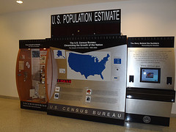
The US Census Bureau can provide information about the composition of your population and workforce.
The Census Bureau has
three main programs that provide demographic data:
Decennial Census
Population Estimates Program
American Community Survey
Notes:
Many of the data elements described in this section rely on data produced by the U.S. Census Bureau. The Census Bureau run many different data programs, but the three most prominent demographic programs are the Decennial Census, Population Estimates Program, and American Community Survey (ACS).
Each of these programs uses different methodologies to tell a similar, but different, stories about the population. Given that these demographic trends can have a profound impact on communities and the available workforce in those communities, it is important to know how and when to use data from these different programs.

Slide 27
The Census Bureau counts the people
Decennial Census
  Counts every resident in the U.S. every 10 years.
  Including sex, age, date of birth, ethnicity/race, household relationship, own/rent.
  Starting in August 2021, the Census Bureau began releasing data from the 2020 Census.
  It is THE count of the people, so best to use at the beginning of a decade
Population Estimates
  Total resident population estimates and demographic components of change (births, deaths, and migration) each year.
    More current than the Census at the end of a decade.
    Can be used for year over year change.
  Estimates by demographic characteristics for the nation, states, and counties.
  Also estimates an annual estimate of housing units
  The reference date for estimates is July 1 each year.
  https://www.census.gov/programs-surveys/popest.html

Slide 28

The Census Bureau counts the people continued
American Community Survey
  Four characteristics: demographic, social, economic, housing
    21 questions about housing unit
    48 questions about each person
  Conducted throughout the year
    2.9 million addresses/about 4.5 million persons
    Roughly 1.5% of the population each year
  Collected via mail, phone, & in-person
  www.census.gov/acs/www

Slide 29
What ACS estimates should you use?
For most rural areas, the
5-years estimates are the most appropriate.
Users should be mindful of the margins of error to ensure that the data support the story they are telling.
Source: http://www.census.gov/acs/www/guidance_for_data_users/estimates/
Notes:
Which ACS estimates to use depends on your circumstances. In most instances, the 5-year estimates will be most appropriate for people working in rural communities.
However, given the smaller sample sizes in smaller and more rural communities, researchers need to be much more mindful of the margins of error.
The 3-year estimates were discontinued.

Slide 30
Section 1a: The trajectory of a region’s population can influence the availability of workers and job opportunities
The U.S. Census Bureau’s Population Estimates Program produces annual population estimates.
A simple index can show how a place has grown relative to the nation or their respective state.
Population Estimates are useful in intercensal years.
  When counts diverge in Census years, the Census is assumed to be correct.
Notes:
This information is covered in greater detail in Section 1a. of the written guide.
Growing places are likely to have more workers and more demand for workers, shrinking places will have fewer workers and less demand.

Slide 31
Section 1b: Net migration and/or natural change drives population change.
Census population estimates data address the components of population change.
  Population change =
  Natural increase (births-deaths) + net int’l migration and
  net domestic migration
  (in-migrants – out-migrants)
These data can show if the region is attracting people, or if people are leaving to find better opportunities.
Notes:
This information is covered in greater detail in Section 1b. of the written guide.
The three big components of population change are natural change (births minus deaths), net domestic migration, and net international migration.
These trends can tell a lot about a region’s trajectory and the extent to which there will be opportunities and sufficient numbers of future workers.

Slide 32
Section 1c, 1d: A population’s age & gender distribution can have significant implications on the availability of workers.
Population pyramids are effective for showing:
  Potential new workers entering the workforce
  Prime age workers leaving the workforce
Gender composition may reflect the types of available jobs.
  e.g., mining attracts more male workers
Notes:
This information is covered in greater detail in Sections 1c. and 1d. of the written guide.
Population pyramids are one way for showing the age and gender of both the population and the workforce. They can show how many workers are of prime working age (i.e., 25 to 54), how many workers are likely to enter the workforce over the next 10 years (i.e., 15 to 24), and how many are likely to age out of the workforce (i.e., 55 to 64).
Simple charts can be used to show just age or gender, but the population pyramid allows for both.
These are often important demographic factors to consider. In places with an aging population and a disproportionately smaller share of new, potential workers employers may find it difficult to find workers because there are fewer workers to find.

Slide 33
Section 1e: A region’s racial and ethnic composition can influence workplace strategies and cultures
Both the Census Population Estimates and the ACS provide data about race and ethnicity.
These considerations can influence communication and outreach strategies
Notes:
This information is covered in greater detail in Section 1e. of the written guide.
Racial and Ethnic considerations are important because we want our initiative to be reflective of our community, both in terms of the people leading and staffing the initiative and the people participating. Moreover, we want to ensure that smaller groups are excluded just because they are less visible in the community.

Slide 34
Section 1f: Per capita income represents a measure of regional wealth
Rising incomes reflect a strengthening economy
  Best to benchmark to state/nation
PCI available through BEA
  Census SAIPE published median household income (MHI)
  ACS also provides MHI by demographic characteristics or household type.
Notes:
This information is covered in greater detail in Section 1f. of the written guide.
Income levels can show a strengthening economy, that may create stronger opportunities for workers. However, in places where the PCIs are rising quickly, workers in lower paying jobs (e.g., retail, service) may find themselves priced out of the community.
Therefore, this information can inform questions such as 1) Is the economy working?, and 2) is the economy working for everyone who lives there?

Slide 35
Section 1g: Regional poverty rates reflect how well the economy works for the entire population
Poverty rates indicate how communities need public assistance or are eligible for state and federal assistance.
SAIPE data covers overall poverty and child poverty.
Notes:
This information is covered in greater detail in Section 1g. of the written guide.
Poverty rates show how well the economy works for everyone. Places with relatively higher poverty rates will face strains on public services and social assistance programs. These information should also lead to additional questions about why those poverty rates are so high, how persistent the poverty is within the community, and how any regional initiatives can address these challenges.
Poverty rates are often also used to inform eligibility for federal funding programs or may affect the match requirements for several different programs.

Slide 36
2. Labor force trends and characteristics
Notes:
This section covers many of the basic labor market indicators.

Slide 37
This section will introduce you to resources that will help you answer questions such as:
How many potential workers are there overall?
How many workers are able to find work?
How well educated is the workforce?
Where do people work relative to where they live, or how far are people willing to go to find work?

Slide 38
Section 2a: An area’s labor force represents everyone age 16+ that is currently employed or seeking employment.
Comparing labor force trends to other labor markets can highlight its relative strength.
The BLS LAUS program counts people where they live (place of residence).
Notes:
This information is covered in greater detail in Section 2a. of the written guide.
Labor force trends can show the relative strength of the region’s workforce. They often track population trends, although places with relatively younger populations will see the labor force outpace population growth and the labor force may not keep pace in places with older populations.
In the example above, we can see that the Hickory, NC MSA is a slow growth area in a relatively fast-growing state.

Slide 39
Section 2b: The unemployment rate is a common indictor of the regional workforce’s relative health and strength.
The unemployment rate is the share of people without a job but are actively pursuing work.
The BLS LAUS program counts people where they live (place of residence).
Notes:
This information is covered in greater detail in Section 2b. of the written guide.
It is always important to understand that the unemployment measures (people out of work, who are actively looking for work) and what it doesn’t measure (people who have fallen out of the workforce). It is also a measure of the resident workforce, not what percent of jobs go unfilled in a given place.

Slide 40
Section 2c: Labor force participation rates reflect the region’s capacity to meet the demand for labor.
Places with high LF Participation rates tend to have younger labor forces.
Places with lower rates may have older populations, greater disability rates, or a large institutionalized population.
Notes:
This information is covered in greater detail in Section 2c. of the written guide.
Labor force participation shows how many people age 16+ are in the labor force. Places with younger populations, or sufficient numbers of jobs to draw people into the workforce, tend to have higher LF Participation rates. Places with older populations and large institutionalized populations have lower LF Participation rates.
The easiest source for this information is the ACS and for most rural places this means the 5-year ACS. These data will not change dramatically on a year-to-year basis.

Slide 41
Section 2d: Educational attainment rates are often used as a proxy for workforce quality.
Can show how the population aligns with the types of available jobs.
Can help prioritize workforce efforts
  High percentage of people with some college may inform push toward degree completion.
Notes:
This information is covered in greater detail in Section 2d. of the written guide.
Educational attainment is a general measure of workforce quality. It can show, at an aggregate level, the types of jobs that best fit the local workforce. For instance, places with relatively high educational attainment rates are often places with large numbers of professional and technical services.
Place with a large share of people with some college, but no degree, may want to focus on degree completion.
It is important to note that these data measure the share of population age 25+ because there tends to be a lot of movement in educational attainment level for people under 25.
Also these data come from the ACS, so all caveats (about margins of error, etc.) apply.

Slide 42
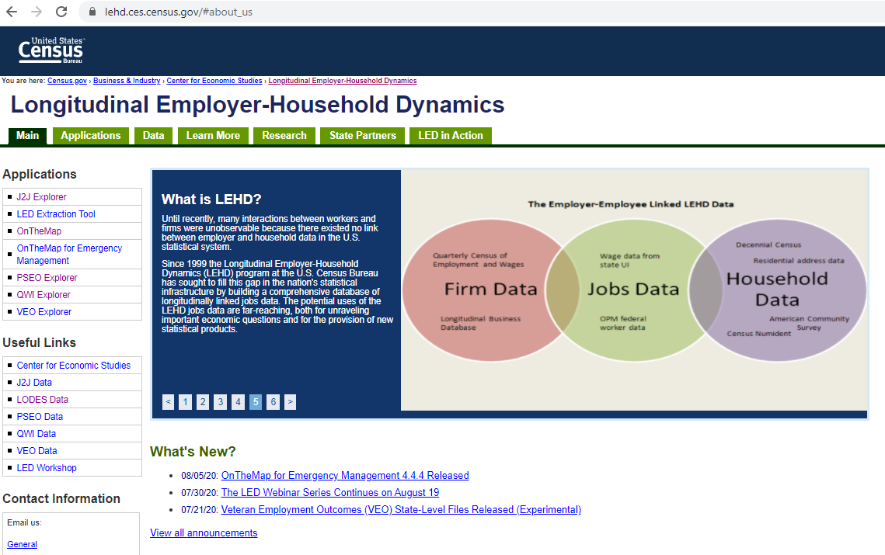
The Longitudinal Employer-Household Dynamics program connects firms to workers to households.
Notes:
This information is covered in greater detail in Section 2e. of the written guide.
The Longitudinal Employer-Household Dynamics (LEHD) program is a partnership between the US Census Bureau & State LMI agencies.
It can give us information about businesses & workers by connecting UI data to people’s household & demographic characteristics. Basically, using their SSN to link two different data sets.
It should be noted that as of January 2023, four states (AK, AR, MI, MS) are no longer participating in the Local Employment Dynamics Partnership. As a result, these states are not currently producing updated data. For more information, refer to the U.S. Census Bureau’s LEHD website: https://lehd.ces.census.gov/state_partners/
By connecting workers job sites to their residences, we can better understand a range of issues, most notably their commuting patterns.
The Census Bureau does fuzz some information when small numbers are involved, so as to protect individual privacy.

Slide 43
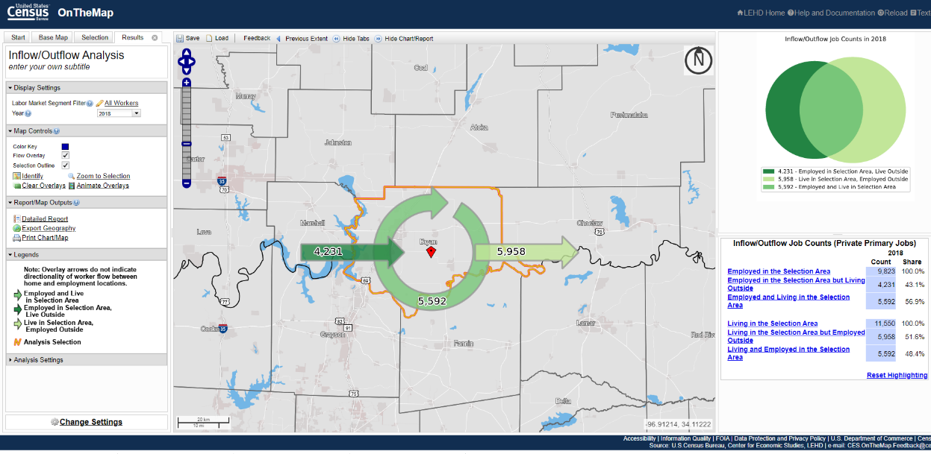
Section 2e: Commuting patterns (Bryan, OK) can show if communities are job centers or bedroom communities.
Notes:
This information is covered in greater detail in Section 2e. of the written guide.
The LEHD’s OnTheMap tool offers several ways to understand your regional workforce and labor shed.
At the most basic level it can tell you whether or not your community/county/region is a job center or a bedroom community.
It can also show how you are connected to other neighboring communities, which may lend itself to potential partnerships or regional collaborations.

Slide 44
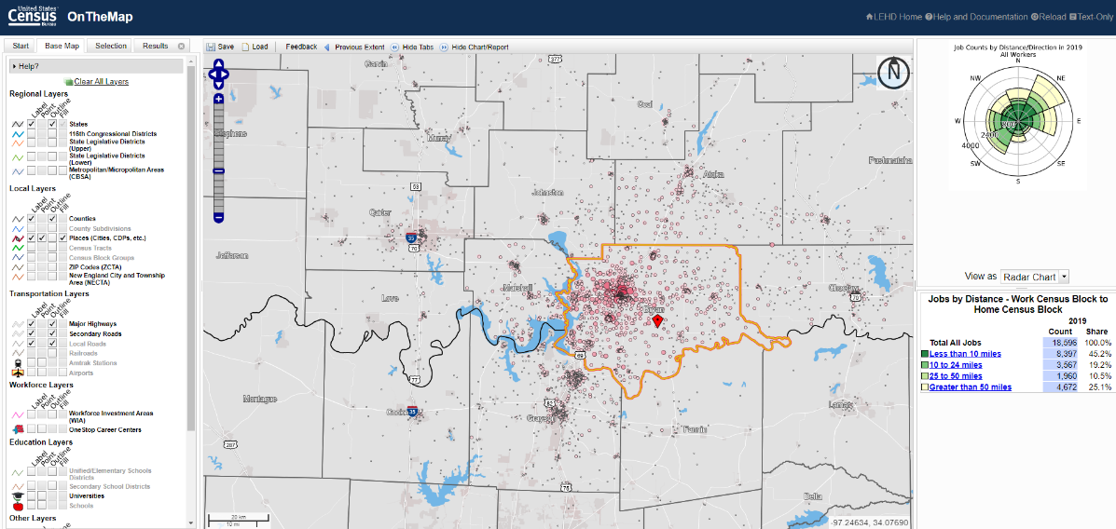
Section 2e: Commuting patterns show how far workers are willing to travel, and how broadly employers can recruit.
Notes:
This information is covered in greater detail in Section 2e. of the written guide.
OnTheMap also allows you to selected geographies like municipalities, counties, or multicounty regions. Moreover, it has a freehand tool that allows you to examine a specific area on the map. So, for instance, if you were interested in the commuting patterns of workers who work in a particular industrial park, you could draw a boundary around that park and analyze that park’s workforce.

Slide 45
Telling the story of labor supply
These data help set expectations, identify broader challenges and gauge the overall health of the regional labor force.
They will not answer every labor market question, but they will allow you to ask better questions.
These data also only tell part of the story—the next section highlights the data sources that will allow you to better understand:
  The needs of local employers, and
  Where workers may find career opportunities.
Notes:
The labor supply data discussed above are most useful to community leaders, economic and workforce development professionals and extension educators. These groups need to understand the broader context of their region and local labor market.
Jobseekers often do not need a detailed understanding of these trends. Rather, they need to understand how to identify potential job and career opportunities.
The next section will focus on sources of labor demand and what jobseekers need to know in order to take advantage of these opportunities.

Slide 46
SOURCES OF LABOR DEMAND
Notes:
This section will focus on sources of labor demand and what jobseekers need to know in order to take advantage of these opportunities.

Slide 47
3. Employment Drivers
Notes:
This section considers the economic activity that drives job growth in a given community.
This section focuses primarily on industry data. Industry data show what companies make. Section 4 will highlight occupation data which describes what workers do.

Slide 48
This section will introduce you to resources that will help you answer questions such as:
What industries employ workers in my region?
What wages do they pay?
How has industry employment changed over time?
What industries employ younger people or people of color?
How many people in my region “make their own job?,” and what kind of business are they in?

Slide 49
Basic v. Non-Basic industries
Non-basic or locally-serving activity (recycled $s)
Export or ‘base’ activity (new $s)
Examples:
Manufacturing
Tourism
Hospitals that provide specialized care
Regional shopping malls
Social Security income
Examples:
Auto repair services
Small convenience retail
General doctor’s and dentist’s offices
Personal services like barber shops
Local restaurants
Notes:
This information is covered in the introduction the employment drivers section of the written guide.
Export or base activities bring new money into the community, which in turn can create additional economic activity.
Locally-serving activities recycle money within the community. The growth or decline of these activities are often driven in large part by population changes. A growing population will increase demand for personal services or grocery stores, a declining population will reduce that demand.
Recognizing these distinctions can help you better understand the quality and number of available job opportunities.

Slide 50
The Quarterly Census of Employment & Wages (QCEW) is the cornerstone of most BLS programs
QCEW data are considered the “universe,” not sample data
Covers all employers subject to state Unemployment Insurance (UI) laws, as well as Federal employees
  Covers 98% of all nonfarm wage and salary workers and 45% of agricultural workers
  Used to be called ES-202 data
  Annual estimates are available in September
QCEW produces detailed geographic data on employment & wages.
  Jobs, payroll, and establishments
  Organized by ownership and NAICS
  Available for all counties, MSAs, states, and the U.S.
Employment measured by place of work.
Notes:
The QCEW is the most important BLS program for understanding industry trends, and these data are derived from the administrative records of the Unemployment Insurance program.
QCEW data can be accessed through the US Bureau of Labor Statistics, as well as your state’s LMI agency.
Unlike the labor force and unemployment data noted in section 2 which measures employment by place of residence, QCEW measures employment by place of work. So basically, where the jobs are located.
Unemployment data=where workers live.
QCEW employment data=where workers work.

Slide 51
Data challenges & issues
Time lag: Data availability takes about 6 months
  Annual estimates for the previous year released in September.
Data suppression: Some industries are suppressed to protect employer confidentiality (the 80/3 rule).
  Data are suppressed when:
    Fewer than three establishments in the given industry for a geographic area.
    One firm constitutes more than 80 percent of area employment in a given industry.
State by state consistency: Laws affecting unemployment insurance coverage vary by state
  Place of work v. Place of Business
  Multiple worksite reporting is optional in Missouri
Notes:
Given the need to protect employer confidentiality, BLS suppresses some QCEW data. This mostly occurs where the number of firms or workers is small, so it is especially important for people working in smaller and more rural communities to understand why these data are not disclosed. The below article from Indiana University effectively describes the suppression process.
http://www.incontext.indiana.edu/2008/july-august/2.asp
Data suppression will limit the amount of publicly-available data, mostly for small geographies (e.g., individual counties) or for people looking for detailed industry data (e.g., 3- to 6-digit NAICS).

Slide 52
Industry employment data are organized using the North American Industry Classification System (NAICS)
Pronounced “nakes”
  www.census.gov/eos/www/naics/
Groups establishments into industries based on the similarity of their production processes.
  20 sectors
  1,069 industries
Revised every 5 years to keep up with changing economy
  Newest version is 2022
Jointly developed across North America
Replaced the Standard Industrial Classification (SIC)
Notes:
Industry data are organized using the NAICS system. It is important understand this classification system in order to properly access and understand the information you need.

Slide 53
North American Industry Classification System (NAICS) - 2017
NAICS level | Example
 | NAICS code | Description
Sector | 31-33 | Manufacturing
Subsector | 311 | Food Manufacturing
Industry group | 3115 | Dairy Product Manufacturing
Industry | 31151 | Dairy Product (except Frozen) Manufacturing
U.S. Industry | 311513 | Cheese Manufacturing
Unique to country; standardization ends at 5-digit code.
Notes:
When doing sub-state work, most data will not be available beyond the 4-digit level. In smaller and more rural places, users will run into data suppressions at the 3-digit level.

Slide 54
NAICS Sectors
(11) Agriculture, Forestry, Fishing & Hunting | (53) Real Estate & Rental & Leasing
(21) Mining, Quarrying, & Oil & Gas Extraction | (54) Professional, Scientific, & Technical Services
(22) Utilities | (55) Management of Companies & Enterprises
(23) Construction | (56) Admin. & Support & Waste Mgmt. & Remediation Services
(31-33) Manufacturing | (61) Educational Services
(42) Wholesale Trade | (62) Health Care & Social Assistance
(44-45) Retail Trade | (71) Arts, Entertainment, & Recreation
(48-49) Transportation & Warehousing | (72) Accommodation & Food Services
(51) Information | (81) Other Services
(52) Finance & Insurance | (92) Public Administration
Notes:
54

Slide 55
NAICS – Things to watch out for
NAICS revisions when comparing data over time
  Crude Petroleum & Natural Gas Extraction (2012 NAICS Code 211111) broken into two new codes in 2017.
    Crude Petroleum Extraction (211120)
    Natural Gas Extraction (211130)
Educational services often does not include all education.
  State schools fall under state government
  Local public schools fall under local government
  Private schools fall under educational services
Notes:
For smaller regions and communities, local school districts can be a leading employer. Consequently, it is important to recognize that much of that employment will fall into local government and not educational services.

Slide 56
Section 3a: Industry employment
BLS’ Quarterly Census of Employment and Wages (QCEW) is our primary source of industry employment.
  Data based on the administrative records from the Unemployment Insurance program.
  Does not include self-employed.
Released Quarterly 6-7 months after the reference period.
  Final annual averages released in September.
Notes:
This information is covered in greater detail in Section 3a of the written guide.
The QCEW can be used to identify the key economic pillars of your local economy.

Slide 57
Section 3a: Industry employment
QCEW also publishes detailed NAICS data.
Data are often suppressed to protect employer privacy concerns.
Data suppressions most common when seeking information about:
  Smaller counties and regions
  More detailed industries
Notes:
This information is covered in greater detail in Section 3a. of the written guide.
QCEW can also be used to better understand the activities within a given sector. For instance, in this example we can see from the previous slide that MFG comprises almost 40 percent of Sheboygan’s employment. But as we dig deeper, we can see that most manufacturing jobs are in fabricated metals and food manufacturing.

Slide 58
Section 3a: Industry employment
There are multiple ways to access QCEW data.
  QCEW data viewer provides relatively easy access to data (2017-2021)
  QCEW searchable databases give access to NAICS data back to 2001.
  State LMI agencies also publish these data.
Notes:
This information is covered in greater detail in Section 3a. of the written guide.
Historical QCEW can also show us a given sector has performed over time. In this example we can see that job growth in Sheboygan has lagged the state and nation, but its manufacturing sector---while still down from the beginning of the century---has outperformed the US manufacturing sector.
So QCEW data can help answer some “Compared to What?” questions and put the industry employment into context.

Slide 59
Section 3b: Industry demographics
Certain activities lend themselves to specific types of workers.
  Gender a big distinction in some sectors (e.g., Men in construction or MFG, Women in Healthcare)
  Age (e.g., youth workers are found primarily in retail, food service)
Do our choices lead to different levels of participation and engagement?
What steps can be taken to ensure a broader audience?
Notes:
This information is covered in greater detail in Section 3b. of the written guide.
Understanding the demographics of different industries can also shape your efforts, depending on if you are focused on specific types of workers (e.g., young/old, male/female, diverse racial/ethnic groups, highly educated/less educated, etc.).
The Quarterly Workforce Indicators (QWI) produced by the LEHD program (described earlier in section 2e.) can provide insight into the demographic characteristics of different industries.

Slide 60
Section 3c: How many workers are involved in Entrepreneurial ventures?
U.S. BEA provides data on sole proprietorships.
  Sole proprietors are businesses w/o employees and who file IRS Schedule C/F.
Sole proprietors often comprise a greater share of employment in more rural areas.
  Source of supplemental income
  Entrepreneurship out of necessity
Notes:
This information is covered in greater detail in Section 3c. of the written guide.
Not all jobs come through employers, and often workers create their own jobs. In rural areas this often happens out of necessity or to create a source of supplemental income.
There are two primary sources for this information, BEA Proprietorship data and Census Nonemployer Statistics, but they show different things.
BEA provides information on how many people are engaged in sole proprietorships and file, for instance, a Schedule C with their taxes.
The Census NES gives some information on non-employers (businesses with no paid employees and receipts greater than $1,000 per year), such as what activities they are involved in and how much did they earn on average.

Slide 61
Section 3c: What entrepreneurial opportunities are available?
Nonemployers are businesses with no paid employees and receipts greater than $1,000 per year.
Trends in nonemployer establishments show where individuals find opportunities to earn extra income or create their own jobs.
Notes:
This information is covered in greater detail in Section 3c. of the written guide.
Nonemployer statistics are gathered by the US Census Bureau.
As of December 2022, 2019 is the most recent available year, as the pandemic created challenges for data collection and processing.

Slide 62
Section 3c: What entrepreneurial opportunities are available?
Nonemployer establishments may represent:
  Gig workers
  Lifestyle entrepreneurs
  Sources of supplemental
  income
Notes:
This information is covered in greater detail in Section 3c. of the written guide.

Slide 63
4. Occupational demand
Notes:
As noted earlier, Industry data describes what companies make; occupations describe what workers do.
These data are the most relevant and useful for supporting efforts to create career pathways initiatives.

Slide 64
This section will introduce you to resources that will help you answer questions such as:
What are the most common occupations in my region?
What do these different occupations pay?
What industries are most likely to employ workers in these occupations?
Which occupations are projected to grow in the future?

Slide 65
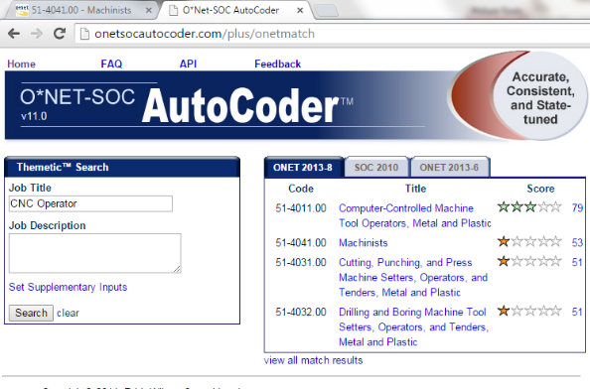
Job titles and occupations are not always the same
Job titles can vary widely between industries, even if they require similar activities
Occupations describe a set of tasks that are standard across industries
Our data are organized by occupations, so we must convert job titles to occupations
O*Net Autocoder
http://onetsocautocoder.com/plus/onetmatch
Notes:
This information is covered in greater detail at the beginning of the ‘Understanding Occupational Demand’ section of the written guide.
It is important to note that people often think in terms of jobs titles, not occupations. However, our data are available by occupation so if all we are given is a job title, or series of job titles, we need to convert them to occupations. The O*Net Autocoder is an easy tool to make that conversion.
Generally speaking O*Net is a tool with which anyone engaged in some kind of regional or community workforce initiative must become familiar.

Slide 66
Organizing Occupations: The Standard Occupational Classification (SOC) System
What is it?
  Classify all occupations in the economy, including private, public, and military occupations.
  Based on job duties, skills, education and/or training.
  Find SOC Data here:
  http://www.bls.gov/soc/
SOC hierarchy
Minor Group (98)
Broad Occupation (459)
Detailed Occupation (867)
Major Group (23)
Notes:
Occupational data are structured in much the same ways as Industry data. So the NAICS equivalent for occupations is the SOC (Standard Occupational Classification) System.
Occupations are sorted by broad occupations groups and then become more detailed.

Slide 67
SOC: example
Major Group
51-0000
Production Occupations
Minor Group
51-3000
Food Processing Workers
Broad Occupation
51-3092
Food Batchmakers
Detailed Occupation
Miscellaneous Food Processing Workers
51-3090
Notes:
Again, SOC codes are similar to NAICS in that a 2-digit code (e.g., 51-0000) is broader than a 6-digit SOC code (e.g., 51-3092).

Slide 68
Standard Occupational Codes
11-0000 Management Occupations
13-0000 Business & Financial Operations Occupations
15-0000 Computer & Mathematical Occupations
17-0000 Architecture & Engineering Occupations
19-0000 Life, Physical, & Social Science Occupations
21-0000 Community & Social Service Occupations
23-0000 Legal Occupations
25-0000 Educational Instruction & Library Occupations
27-0000 Arts, Design, Entertainment, Sports, & Media Occupations
29-0000 Healthcare Practitioners & Technical Occupations
31-0000 Healthcare Support Occupations
33-0000 Protective Service Occupations
35-0000 Food Preparation & Serving Related Occupations
37-0000 Building & Grounds Cleaning & Maintenance Occupations
39-0000 Personal Care & Service Occupations
41-0000 Sales & Related Occupations
43-0000 Office & Administrative Support Occupations
45-0000 Farming, Fishing, & Forestry Occupations
47-0000 Construction & Extraction Occupations
49-0000 Installation, Maintenance, & Repair Occupations
51-0000 Production Occupations
53-0000 Transportation & Material Moving Occupations
55-0000 Military Specific Occupations
https://www.bls.gov/soc/2018/major_groups.htm
Notes:
Know your occupational groups!
Healthcare practitioners include doctors & nurses
Healthcare support occupations include home health aides, nurses’ aides, orderlies, etc.

Slide 69
SOC codes are revised periodically, and we are currently in the process of implementing the 2018 revision.
The 2010 SOC revision resulted in:
  More detailed IT (e.g., Info. Security Analysts) & Healthcare occupations (e.g., MRI Techs).
  Also new ‘green’ jobs: Solar Photovoltaic Installers, Wind Turbine Techs.
The 2018 SOC revision added 27 detailed occupations and 1 minor group.
Occupation descriptions can be a bit dated, but local employers can often provide better descriptions
The May 2021 estimates will be the first estimates using only the 2018 SOC, and will be published in the spring of 2022
Given the field’s fast changing nature, many of these changes were for comp and math occupations.
  More detail: Web developer to Web Developers or Web & Digital Interface Designers.
  Breaking out ‘All Others” to add new detailed occupations.
    e.g., Database architects, Project Management Specialists, Data Scientists
2018 SOC User Guide: https://www.bls.gov/soc/2018/soc_2018_user_guide.pdf
Notes:
These codes change over time to adjust to a changing economy. An update on the most recent changes can be found here: https://www.bls.gov/soc/2018/#classification

Slide 70
Section 4a: Occupational employment data show the relative demand for different occupations.
Shows areas of opportunity for jobseekers, and areas of need for local employers.
Change over time highlights the changing demand for workers
Notes:
This information is covered in greater detail in Section 4a. of the written guide.
Occupational data can show what are the most common occupations in a given field, and in turn give you a sense of where there is the greatest demand (at least by volume, not necessarily by critical need) for a specific occupation.

Slide 71
Section 4a: Occupational wage data can help both employers and jobseekers set wage expectations.
Different wage levels reflect the differences between high and low paying employers.
  Wage percentiles often used as a proxy for entry-level or experienced wages.
Wage levels can help stakeholders assess the quality of job opportunities.
Notes:
This information is covered in greater detail in Section 4a. of the written guide.
Wages are critical information because they can help workers and job seekers set expectations and show employers if they are paying a competitive wage.
BLS published wages at different percentiles. These ranges show the differences in wages between high or low paying employers. However, they are often used as a proxy to show the differences between entry-level wages and experienced wages in a given occupation.

Slide 72
Section 4b: Industry-occupation staffing patterns show the relationship between industries and occupations.
Common occupations in Motor Vehicle Parts MFG (NAICS 3363)
Industries that commonly employ machinists (SOC 41-4041)
Notes:
This information is covered in greater detail in Section 4b. of the written guide.
Understanding staffing patterns can show what types of workers are employed by individual industries, and what types of industries employ workers in specific occupations.
These staffing patterns can also help you gauge what types of jobs will need to be filled as industries grow, or what types of workers have been let go by industries that are losing employment.

Slide 73
Section 4c: Occupational projections provide some insight about the changing demand for different occupations.
Forecast
  No one has a crystal ball
  Past trends often dictate future projections.
State LMI agencies produce 10-year projections for the state and sub-state regions.
BLS publishes national projections
Notes:
This information is covered in greater detail in Section 4c. of the written guide.
Occupational projections are one of the most commonly used products published by state LMI agencies. They provide an estimation of what types of jobs will need to be filled over the next decade. This information can help jobseekers select careers, or help educators prepare training programs.
Often these projections have information on openings and that can provide a better indication about the number of future opportunities in a given occupation.

Slide 74
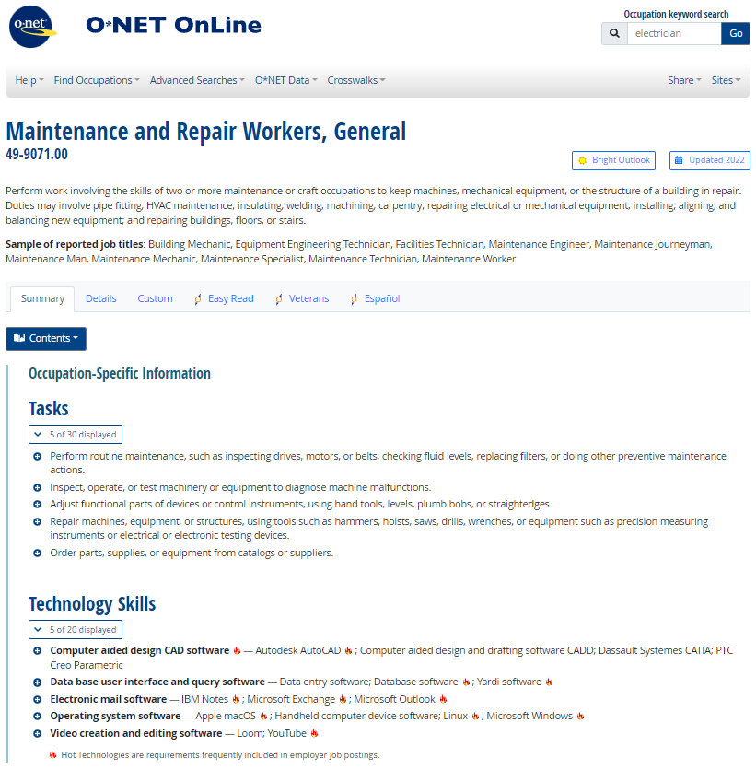
Section 4d:
The resources available through O*Net provide insight into what is required to fill different occupations.
O*Net covers:
  Key data points include:
    Knowledge, Skills & Abilities (KSAs)
    Job tasks
    Projected growth
    Wages
    Education requirements
    Related occupations
  “Bright Outlook” Occupations:
    Projected to grow much faster than average
    Projected to 100,000+ openings
    New & Emerging occupation in a high growth industry
  “Greenness”—Where do occupations fit within the green economy
Notes:
This information is covered in greater detail in Section 4d. of the written guide.
O*Net provides detailed information on hundreds of occupations. Anyone involved in organizing community or regional workforce initiatives should familiarize themselves with O*Net and its variety of tools/resources.

Slide 75
Section 4d: Career Pathways for General Maintenance and Repair Workers in the Rocky Mount, NC MSA
Electrical Engineering Technicians
2020 Area Jobs: 30
Median Wage: $30.76
Associate’s degree
Plumbers, Pipefitters & Steamfitters
2020 Area Jobs: 110
Median Wage: $19.64
HVAC Mechanics & Installers
2020 Area Jobs: 140
Median Wage: $18.33
General Maintenance & Repair Workers
2020 Area Jobs: 900
Median Wage: $18.91
Industrial Machinery Mechanics
2020 Area Jobs: 190
Median Wage: $21.30
Long-term OJT, Apprenticeship
Automotive Service Technicians & Mechanics
2020 Area Jobs: 260
Median Wage: $18.386
Machinery Maintenance Workers
2020 Area Jobs: 140 Median Wage: $16.53
Moderate OJT- Post-secondary, no degree cert.
Janitors & Cleaners
2020 Area Jobs: 490
Median Wage: $12.43
Helpers, Gen. Maint. & Repair Workers
2020 Area Jobs: N/D
Median Wage: $14.89*
Landscaping & Grounds Keeping Workers
2020 Area Jobs: 270
Median Wage: $11.34
Short-term OJT
*State Median Wage
Source: O*Net; Federal Reserve Bank of Philadelphia Occupational Mobility Explorer, BLS 2020 Occupational Employment & Wage Statistics
Notes:
This information is covered in greater detail in Section 4d. of the written guide.
Using this information, the O*Net database provides a set of occupations requiring similar education, tasks, knowledge, skills and abilities. Connecting this information to other sources—like the Occupational Employment and Wages Statistics and the Occupational Employment Projections—can allow people to begin constructing basic career pathways or career lattices.
These diagrams can show occupations that might prepare people to enter maintenance occupations, even if they lack the experience. It also shows other related occupations that might present growth opportunities if workers pursue additional training and experiences. These types of diagrams do not provide all the answers, but nevertheless can help frame someone’s career exploration activities. The Philadelphia Federal Reserve Bank recently constructed an Occupational Mobility Explorer tool, which was intended to help people transfer from one occupation to another. That tool not only draws upon O*Net, but also several other public (e.g., OES, Occupational Projections) and Proprietary (e.g. Burning Glass Technologies analysis of online job advertisements) data sources. Data are available for the 33 largest U.S. metros, but much of this information is likely applicable to smaller places as well. This tool, and information about how it was constructed, can be found here: https://www.philadelphiafed.org/surveys-and-data/community-development-data/occupational-mobility-explorer

Slide 76
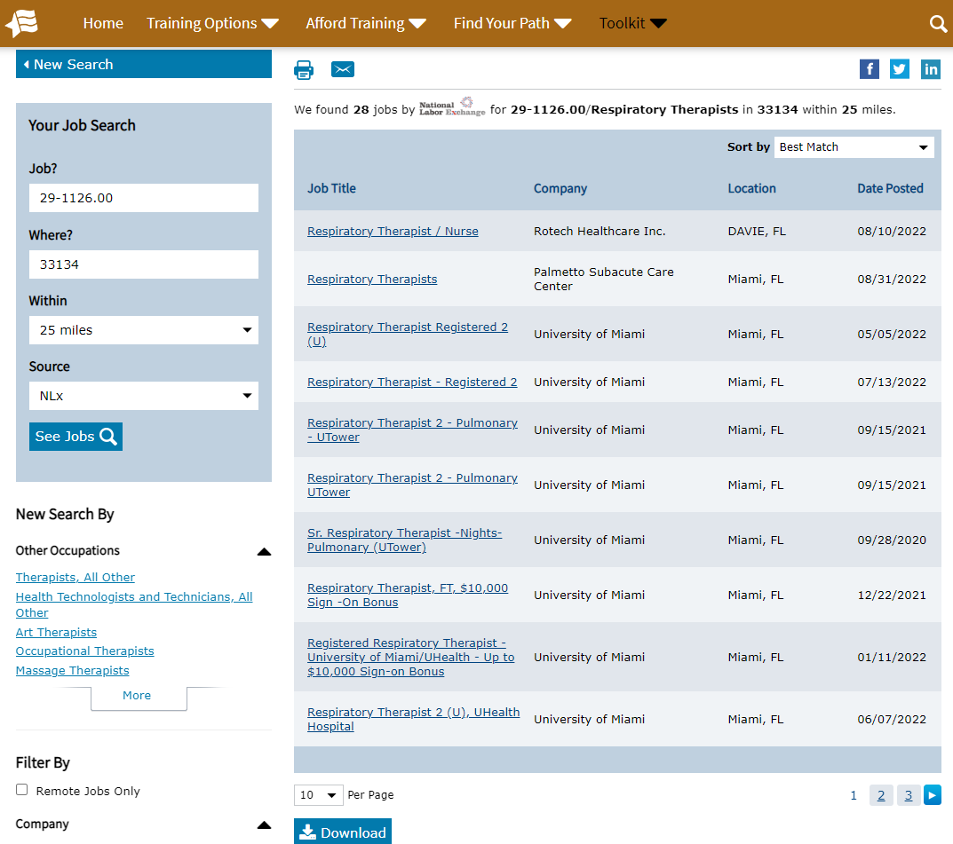
Section 4e: Online job postings can help show current demand for specific occupations.
Job postings are available through the National Labor Exchange (NLx), accessed through O*Net
Proprietary ‘Real-Time’ LMI Vendors include:
  Lightcast (formerly EMSI Burning Glass)
  Help Wanted Online (based on Conference Board Data)
  Chmura Economics JobsEQ
Notes:
This information is covered in greater detail in Section 4e. of the written guide.
Online job postings have become an increasingly important source of labor market information, and web-scraping technology can extract a lot of information (e.g., in-demand skills and certifications) from job advertisements found in places like job boards (e.g., Monster, Career Builder), government agencies (e.g. USAjobs.gov), newspaper ads, and corporate websites.
A number of proprietary data vendors (e.g., EMSI Burning Glass, Chmura Economics) work to aggregate the data available in job postings and in doing so have created ‘Real-Time LMI’. Access to these tools, however, can prove expensive.
If access to proprietary job postings data are unavailable, access to online job postings are available through the National Labor Exchange (NLx). The National Labor Exchange aggregates state job posting banks and then augments those postings with additional sources (e.g., CareerBuilder, Indeed, ZipRecruiter). Although this does not provide the analytical tools available through proprietary data vendors, it does allow users to see what types of jobs in a given occupation are available in their region. These postings are by no means a definitive measure of local occupational demand, but they can give job seekers and relevant stakeholders (e.g., counselors) a basic understanding of what area employers are looking for from applicants. Access to the NLx search tool is available through “Find Jobs” button on O*Net’s individual occupation summary reports.

Slide 77
5. Filling needs
Notes:
The section will focus on resources for understanding the supply of graduates from education and training programs.

Slide 78
This section will introduce you to resources that will help you answer questions such as:
How many people completed relevant degrees and completions from area post-secondary institutions?
What are the relevant credentials for a given occupation?

Slide 79
O*Net provides crosswalks that help connect industries to occupations, and then occupations to educational programs
NAICS (industries) to SOC (occupations)
  Staffing pattern matrix, US Bureau of Labor Statistics
SOC (occupations) to CIP (curricula)
  CIP 2010 crosswalk, National Center for Education Statistics
http://online.onetcenter.org/crosswalk/
Notes:
Educational program completer data are organized by Classification of Instructional Programs (CIP) codes.
O*Net provides a crosswalk connecting SOC codes to CIP codes.

Slide 80
Classifying Educational Programs:
Classification of Instructional Programs (CIP Codes)
47 “Families”
  15. Engineering Technologies and Engineering-Related Fields
  Instructional programs that prepare individuals to apply basic engineering principles and technical skills in support of engineering and related projects or to prepare for engineering-related fields.
1,824 “Codes”
  15.0616 Semiconductor Manufacturing Technology
  A program that prepares individuals to apply basic engineering principles and technical skills to operate and monitor equipment for the fabrication of semiconductors or microchips from silicon wafers, and to troubleshoot, maintain, and repair the specialized equipment used in this process. Includes instruction in AC and DC circuits, digital fundamentals, solid state devices, manufacturing processes, vacuum principles and technology, industrial electronics, quality assurance, and semiconductor manufacturing technology.
377 “Groups”
  15.04 Electromechanical Instrumentation and Maintenance Technologies/Technicians
  15.05 Environmental Control Technologies/Technicians
  15.06 Industrial Production Technologies/Technicians
http://nces.ed.gov/ipeds/cipcode/browse.aspx?y=55
Notes:
This information is covered in greater detail in Section 5a. of the written guide.
These codes are structured similarly to NAICS and SOC codes. CIP codes help organize completions by field of study, and like NAICS and SOC codes these data are available at varying levels of aggregation (e.g., 01-Agriculture, Agriculture Operations and Related Sciences; 01.09-Animal Sciences; 01.0905-Dairy Science).

Slide 81
Section 5a: Education and training data
Postsecondary Institutions – Programs, Graduates, Enrollments, etc.
  Integrated Postsecondary Education Data System (IPEDS) – NCES
    http://nces.ed.gov/datatools/
  Data comes from individual institutions, so how institutional researchers assign programs to different CIP codes may prove inconsistent across institutions.
    E.g., One institution may classify its Construction Management program as Construction Management (CIP 52.2001), while others may classify it as General Business and Commerce (52.0101).
High Schools – Graduates, Graduate Intentions, Enrollments, etc.
  State Dept. of Educations provide relevant information
  Some states survey graduates which can help show how many high school graduates go to college (2-year, 4-year), enter the workforce, or join the military.
Notes:
This information is covered in greater detail in Section 5a. of the written guide.
Post-secondary completer data can be found by using the U.S. Dept. of Education’s National Center for Education Statistics' Integrated Postsecondary Education Data System (IPEDS).
State departments of education often provide information about Graduates, Graduate Intentions, Enrollments, etc. and these data can be used to understand what share of HS graduates go to college or enter the workforce.

Slide 82
Section 5a: Post-secondary completers
The IPEDS data tools are not always user-friendly.
  The IPEDS College Navigator is useful for looking up information for individual institutions.
Some proprietary vendors publish these data with more user-friendly tools.
Notes:
This information is covered in greater detail in Section 5a. of the written guide.
Completer data can help show the extent to which area institutions can help meet employer needs to fill in-demand jobs. It is important to note that not all jobs are filled by recent area graduates. Jobs can be filled by internal candidates, people working elsewhere in the region, or in-migrants moving to the region. Similarly, not all completers end up working in their field of study. So it is misguided to measure gaps by subtracting the number of completers from the projected demand.
An experimental dataset, Post-Secondary Employment Outcomes (PSEO) draws on data from public universities, state departments of education, state labor market information agencies and the U.S. Census Bureau. It shows industries where public college and university graduates find work upon completing their degrees as well as how many find work in the state. Not all states participate in this program, so if data are unavailable in your state check with your state LMI agency to see if they are planning to participate in the future.
https://lehd.ces.census.gov/data/pseo_experimental.html

Slide 83

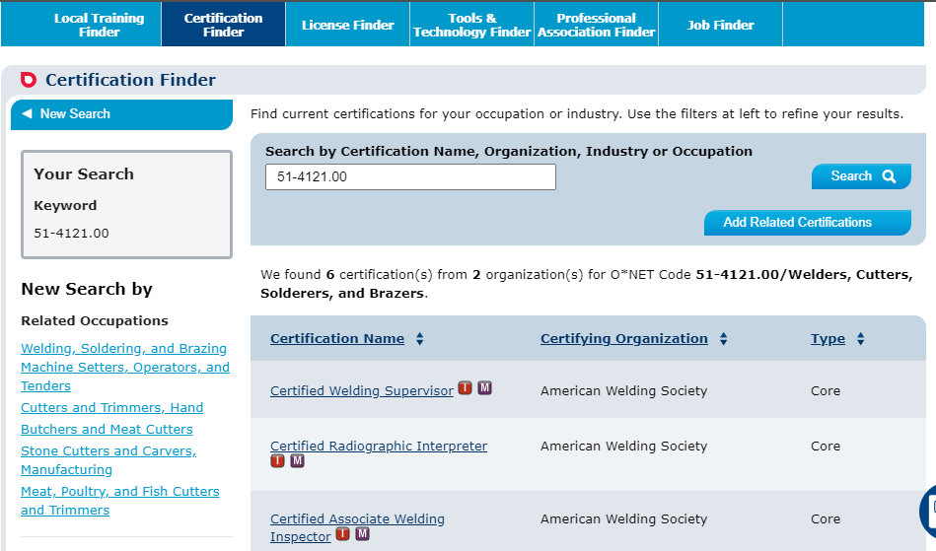
Section 5b: Credentials
Certificates are awards conferred by post-secondary institutions that show completion of a non-degree program of study.
Occupation certifications are awarded by industry or professional associations. Individuals receiving certifications must demonstrate a designated set of knowledge, skills & abilities.
Occupational license are awarded by state licensing boards. They allow workers to practice specific occupations or vocations (e.g. teachers, nurses, surveyors, etc.) within that state.
Notes:
This information is covered in greater detail in Section 5b. of the written guide.
Not all jobs require post-secondary education, but many do require some form of professional credential. While there is no centralized database on the number of credentials awards in a region, we can identify the commonly required credentials for any given occupation by using the O*Net database.

Slide 84
6. Integrating other data sources
Notes:
The data sources described above are not the only information sources available to answer labor market questions. This section covers additional sources that can be used to better understand you labor force.

Slide 85
This section will help you:
Think through the benefits of qualitative research, and better understand the caveats associated with this research.
Become more familiar with other data resources (e.g., proprietary sources, data aggregators) that can help you answer many basic labor market questions quickly.

Slide 86
Section 6a: Focus groups and interviews
Quantitative research can identify patterns, qualitative research can uncover the processes that create those patterns.
  The information can help interpret and validate the quantitative research.
Limiting factors for gathering this information:
  Time,
  Resources
  Willingness of participants
Employer input can be very informative, but:
  Beware selection bias,
  Involve the right person (e.g., CEO v. HR manager) and you ask them questions that they can answer, and
  Recognize their bias:
    Do they think their workforce needs are unique?
    Do they consider what is good for both the firm and the worker?
These conversations can also help you identify potential private sector partners for your efforts.
Notes:
This information is covered in greater detail in Section 6a. of the written guide.
Qualitative information is critical for any initiative. Interviews and/or focus groups provide an opportunity for researchers to validate and better interpret their findings. Real-world examples can also ‘put a face’ on the data and allow researchers to better communicate their findings and make them more compelling.
That said, it is always important to ask people questions that they can capably answer otherwise they are just providing speculation.
This engagement with key stakeholders and employers can also help you identify potential partners and collaborators.

Slide 87
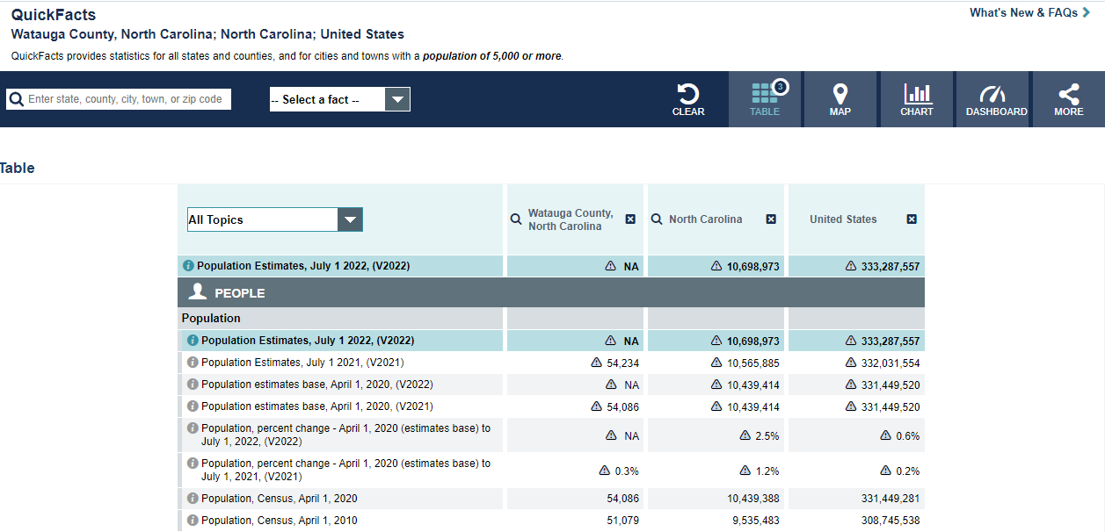
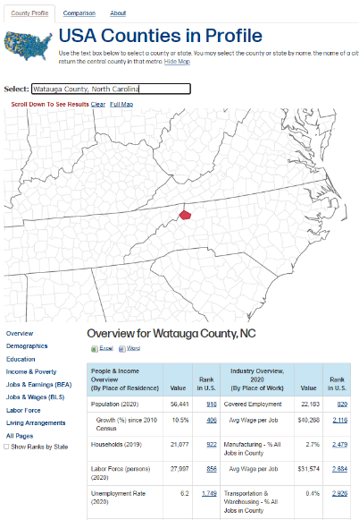
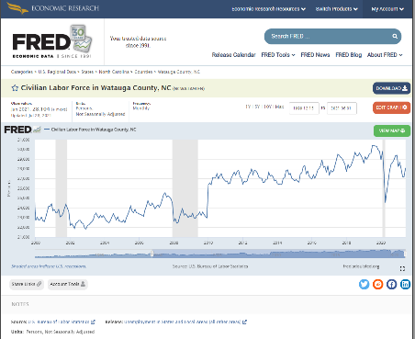
Section 6b: Data aggregators often provide easy access to an array of publicly-available data.
Some provide access to general regional (e.g., StatsAmerica, Census Quickfacts) or economic data (FRED).
Others focus on specific issues
  Tech Talent
  Living Wages
Notes:
This information is covered in greater detail in Section 6b of the written guide.
The data sources covered above, highlight the agencies that produce these individual datasets. Several data aggregators like StatsAmerica or the St. Louis Federal Reserve Bank’s Federal Reserve Economic Data (FRED) are publicly-funded data aggregators that enable users to get different data elements from one source. As a result, they have the potential to be a potential labor saver. That said, it is always important to know where these data come from and if they are the most current available data.

Slide 88
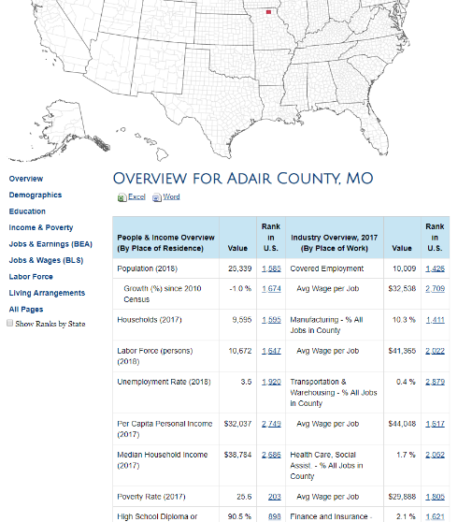
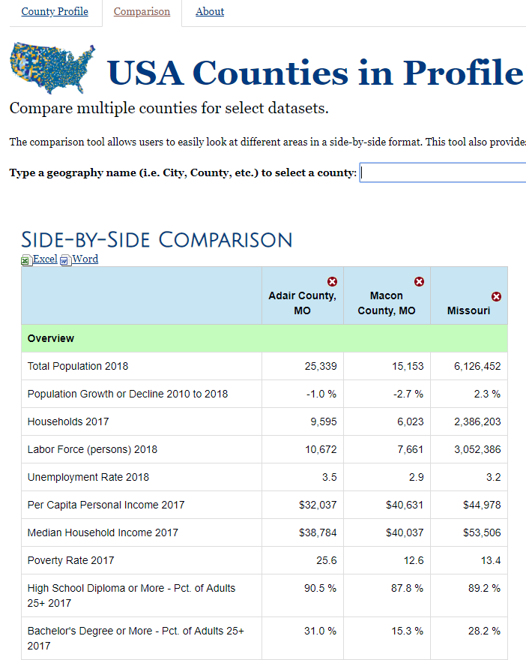
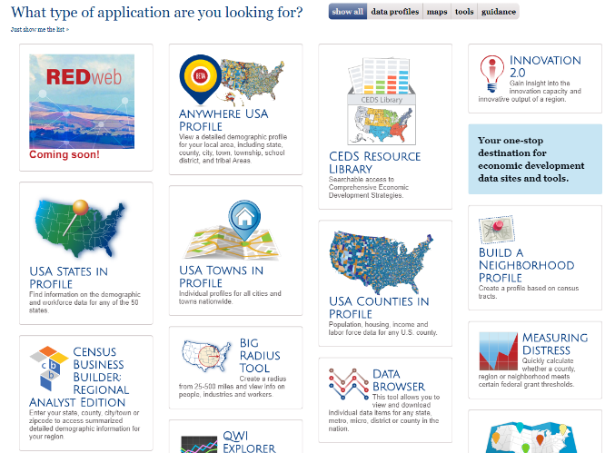
StatsAmerica is funded by US EDA, with primary purpose of helping RPCs with their CEDS process.
Developed and supported by Indiana University, StatsAmerica provides:
  Basic economic, demographic, education data, etc.
  Easy comparisons of counties and states
  Basic innovation & cluster analysis
Other tools: Radius, Build a neighborhood.
Links to other tools: QWI, OTM, etc.
www.statsamerica.org
Notes:
This information is covered in greater detail in Section 6b. of the written guide.

Slide 89

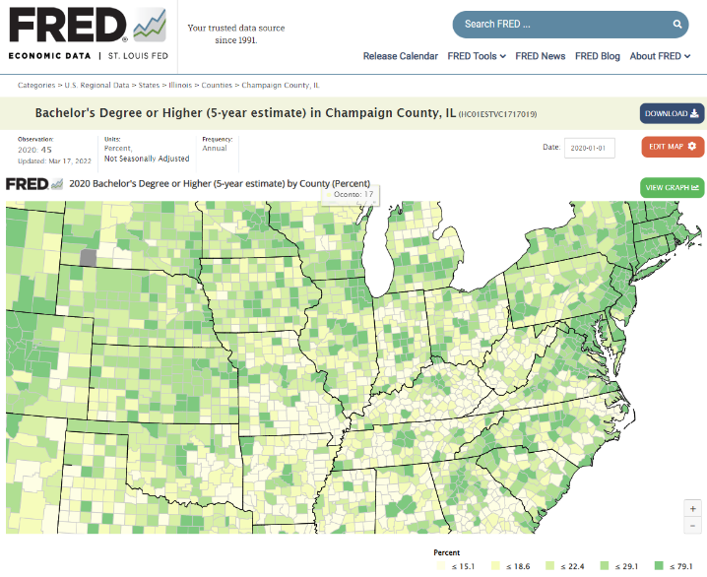
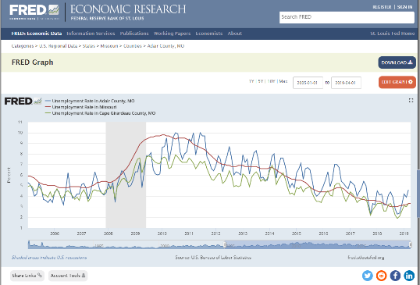
The St. Louis Federal Reserve’s FRED (Federal Reserve Economic Data) tool is another great data aggregator.
Good place to look up basic economic information.
  Graphing function
  available for quick charts
  https://fred.stlouisfed.org/
FRED Maps allow for quick visual display of socio-economic data.
Also available in App Form!
Notes:
This information is covered in greater detail in Section 6b. of the written guide.

Slide 90
Section 6b: Private data vendors are another option
Benefit of these tools include:
  Estimates that allow for greater industry/geographic detail
    Get past data suppressions
  User-friendly, labor-saving tools
  Common vendors include Lightcast (formerly EMSI Burning Glass), Chmura Economics’ JobsEQ, Moody’s Analytics, etc.
A few key caveats:
  Know how the sausage is made…and be able to explain it.
  Know the strengths & weaknesses of their data
  Cross-check vendor data against public data to ensure quality
  Subscriptions can be expensive.
Also remember that all these data rely heavily on the publicly-available data we discussed today.
Notes:
This information is covered in greater detail in Section 6b. of the written guide.
For people who can afford them, private data vendors are another option for gathering the necessary information. The vendors often provide labor saving tools. Moreover, they use modeled data to get around data suppressions and give users estimates in places where they might not have any number with which to work.
When using proprietary data sources it is always important to know how they produce their data and any inherent strengths and weaknesses.

Slide 91
CONCLUDING THOUGHTS

Slide 92

Getting started
All places have unique needs, so it is critical to first understand:
  Local opportunities and challenges, and
  The priorities of local leaders, employers and stakeholders.
Information can help you better understand the regional workforce, as well as help you start the conversations necessary to enlist support for your efforts.

Slide 93
Set the direction
Examine key issues & focus areas
Frame data for different audiences
Validate data
Understand the priorities of community leaders
Develop research plan that speaks to those priorities
Consider how the information can help build support
Determine strategic focus
  Target industry (e.g., construction) or occupational (e.g., IT) focus
  Specific populations (e.g., Youth, disabled, etc.)
Customize information according to participant needs
  Stakeholders: Emphasis on labor market conditions
  Jobseekers: Focus on employment opportunities & career exploration
Build in multiple feedback opportunities for stakeholders (e.g., employers, instructors)
Use feedback to identify critical information and remaining information gaps.

Slide 94
Throughout, it is important to recognize that no one data source will answer all your labor market questions.
Regional priorities often reflect the characteristics of the local labor force.
Identifying the industries that drives regional growth can help identify promising employment opportunities for local workers.
Understanding industry demand allows jobseekers to more effectively select occupations that present attractive career opportunities within the context of their local economy.
The ability to locate regional education and training resources can help workers better access the programs they need to prepare for, or advance in, potential careers.
Notes:
Remember that your actions should not occur in a vacuum and they should reflect the interests and priorities of the region and its leadership.

Slide 95
Just as your community workforce efforts will require partners, so too should your labor market research.
Organizers should actively engage others (e.g., employers, community leaders, subject matter experts, etc.) to help interpret and validate the information and findings.
Develop a relationship with your state’s LMI agency, as they can help you more effectively access, understand, and use labor market data and information.
  Find your state’s LMI agency here: https://www.lmiontheweb.org/what-we-do/agency-directory/
Notes:
Just as your community and regional efforts require partners and collaborators, so too does your research. Your state’s LMI agency represents an important resource for helping you find the information you need in your efforts.

Slide 96
Thank you.
Mark C. White, Ph.D.
Clinical Associate Professor
Department of Agricultural and Consumer Economics
University of Illinois, Urbana-Champaign
whitemc@illinois.edu

