Slide 1

MODULE 3 SLIDES:
Mapping Pathways
to Economic Stability
Tanya J. Hall, Purdue University; Michael D. Wilcox, Jr., Ph.D.,
Purdue University; Joy Moten-Thomas, Fort Valley State University;
and Paul Hill, Ph.D., Utah State University

Slide 2
Learning Objectives
Increase knowledge about career pathways, purpose and how they are created
Develop strategies to work with community leaders/businesses to develop career pathways
Improve awareness of how training/education programs are aligned to meet career pathway needs
Enhance understanding of how to implement the developed career pathway in the community
Increase awareness of existing industry career pathways and ways to incorporate unique pathways related to small businesses and remote work

Slide 3
What is a Career Pathway?
A combination of rigorous and high-quality education, training, and other services that:
  Aligns with the skill needs of industries in the economy of the state or regional economy involved;
  Prepares an individual to be successful in any of a full range of secondary of postsecondary education options, including apprentices;
  Includes counseling to support an individual in achieving the individual’s education and career goals;
  Includes education offered concurrently with and in the same context as workforce preparation activities and training for a specific occupation or occupational cluster;
Notes:
The federal Workforce Innovation and Opportunity Act (WIOA) defines the term “career pathway” as a combination of
rigorous and high-quality education, training, and other services that—
• aligns with the skill needs of industries in the economy of the state or regional economy involved;
• prepares an individual to be successful in any of a full range of secondary of postsecondary education options,
including apprenticeships registered under the Act of August 16, 1937;
• includes counseling to support an individual in achieving the individual’s education and career goals;
• includes, as appropriate, education offered concurrently with and in the same context as workforce preparation
activities and training for a specific occupation or occupational cluster;

Slide 4
What is a Career Pathway? (continued)
Organizes education, training, and other services to meet the particular needs of an individual in a manner that
Accelerates the educational and career advancement of the individual to the extent practicable;
Enables an individual to attain a secondary school diploma or its recognized equivalent, and at least one recognized postsecondary credential; and
Helps an individual enter or advance within a specific occupation or occupational cluster.
Notes:
• organizes education, training, and other services to meet the particular needs of an individual in a manner that
accelerates the educational and career advancement of the individual to the extent practicable;
• enables an individual to attain a secondary school diploma or its recognized equivalent, and at least one recognized
postsecondary credential; and
• helps an individual enter or advance within a specific occupation or occupational cluster .
A simpler definition of career pathways is a method of providing clarity to job seekers on how to advance their career
trajectory within a specific industry. Career pathways are also a valuable tool to assist industry, workforce development
agencies, education and training entities and other community partners develop concrete processes for aligning their
respective services to develop integrated pathways that make it easier for everyone to navigate.

Slide 5
What Do Career Pathways Look Like in Your Community?
Consider the career pathway elements from the past two slides…
What elements exist in your community? Are they accessible and high quality?
What is missing?
Are they seamless? Can you enter at any level? Are the credentials stackable*?
Are the options diverse? Are they integrated?
Why are they important?...
* U.S. Department of Labor defines a stackable credential as one that is “part of a sequence of credentials that can be accumulated over time to build
up an individual’s qualifications and help them to move along a career pathway or up a career ladder to different and potentially higher-paying jobs.”
Source: Scaling “Stackable Credentials”: Implications for Implementation and Policy. 2014. Center for Postsecondary and Economic Success . Accessed
at: https://files.eric.ed.gov/fulltext/ED561777.pdf
Notes:
Typically, career pathways are industry-driven and designed to outline a connected system of education and training
programs that build upon each other to help a job seeker/worker advance in their career. The state of Michigan published
a report, “A Practical Guide to Developing Career Pathways ,” and defined these key features of career pathways:
• They connect and articulate the full range of K-12, adult education, post-secondary, and other education and training,
with seamless transitions between “levels” and no “dead ends”;
• They have multiple on- and off-ramps to make it easy for individuals to start, stop, and re-enter education and
training;
• They embed “stackable” industry-recognized credentials*;
* U.S. Department of Labor defines a stackable credential as one that is “part of a sequence of credentials that can be accumulated over time to build
up an individual’s qualifications and help them to move along a career pathway or up a career ladder to different and potentially higher-paying jobs.”
Source: Scaling “Stackable Credentials”: Implications for Implementation and Policy. 2014. Center for Postsecondary and Economic Success . Accessed
at: https://files.eric.ed.gov/fulltext/ED561777.pdf
• They make work a central context for learning, through on-the-job training, Registered Apprenticeship, work-based
internships and mentorships, and other avenues;
• They accelerate educational and career advancement through assessment of prior learning and experience, integrated
“basic” education and technical training, and other strategies; and
• They provide integrated supports like coaching and advising and services like childcare and transportation assistance,
especially at education and career transition points.

Slide 6
Benefits of Fostering Career Pathways
Benefits to Businesses
A process for thinking comprehensively about their expectations for each of their positions and clearly defining both necessary and realistic requirements;
An opportunity to ensure that education and training are aligned to actual industry and company needs;
A ready talent pipeline with the right education, skills, and credentials;
A strategy for increasing employee retention;
A model for supporting career advancement, succession planning, and back-filling; and
A process for connecting to new and more diversified talent pools in tight labor markets facing worker shortages.
Notes:
Benefits to Businesses
• A process for thinking comprehensively about their expectations for each of their positions and clearly defining
both necessary and realistic requirements;
• An opportunity to ensure that education and training are aligned to actual industry and company needs;
• A ready talent pipeline with the right education, skills, and credentials;
• A strategy for increasing employee retention;
• A model for supporting career advancement, succession planning, and back-filling; and
• A process for connecting to new and more diversified talent pools in tight labor markets facing worker shortages.

Slide 7
Benefits of Fostering Career Pathways
Benefits for Students/Job Seekers/Workers
A career development “roadmap” that takes the mystery and guesswork out of understanding what careers and career progression looks like
A way for students/job seekers/workers to see themselves in careers and have access to career development information and experience
Education and training that is aligned to “real-world” occupational progressions and workforce needs;
More opportunities to learn on the job and accelerated career advancement opportunities;
New career entry and advancement opportunities, and
Integrated supports and career coaching.
Notes:
Benefits for Students/Job Seekers/Workers
• A career development “roadmap” that takes the mystery and guesswork out of understanding what careers and
career progression look like in various industries and what the real requirements are for career advancement
• A way for students/job seekers/workers, particularly those with multiple barriers to employment and advancement,
to see themselves in careers and have access to career development information and experience they
might not otherwise be exposed to;
• Education and training that is aligned to “real-world” occupational progressions and workforce needs;
• More opportunities to learn on the job;
• Accelerated career advancement opportunities;
• New career entry and advancement opportunities, particularly for individuals with barriers to employment and
career development; and
• Integrated supports and career coaching.

Slide 8
Benefits of a Fostering Career Pathways
Benefits to Community Partners
(workforce development, education, human services, and related systems)
A process for better aligning and integrating services and resources;
Reduced duplication of efforts and investments;
Improved outcomes for a variety of customer groups;
Improved access to and engagement of previously-disengaged populations;
Better connections to business and industry partners and alignment with their workforce needs;
Stronger relationships with other public partners; and
Increased opportunities for better service utilization and coordinated service planning and delivery.
Notes:
Benefits for Students/Job Seekers/Workers
• A career development “roadmap” that takes the mystery and guesswork out of understanding what careers and
career progression look like in various industries and what the real requirements are for career advancement
• A way for students/job seekers/workers, particularly those with multiple barriers to employment and advancement,
to see themselves in careers and have access to career development information and experience they
might not otherwise be exposed to;
• Education and training that is aligned to “real-world” occupational progressions and workforce needs;
• More opportunities to learn on the job;
• Accelerated career advancement opportunities;
• New career entry and advancement opportunities, particularly for individuals with barriers to employment and
career development; and
• Integrated supports and career coaching.

Slide 9

Steps for Building Career Pathways
Create a task force of partners
Engage with targeted businesses
Develop a career pathways map
Analyze the region’s education and training portfolio
Design/modify education and training programs
Determine training program’s sustainability model
Develop an implementation and assessment plan
Implement programming, evaluate outcomes and adjust as necessary
1

Slide 10

HELP WANTED: APPLY WITHIN …
Notes:
NOTE: This section of Module 3 was developed as to assist communities in strengthening their working relationships with their community’s entrepreneurs/small businesses and to gain a better understanding of entrepreneur’s existing workforce needs. The Extension educator and FORWARD task force are tasked with working together to identify and help individuals who are unemployed and underemployed consider pursuing local employment opportunities provided by their community’s entrepreneurs/small businesses. The Extension educator and FORWARD task force will work with program participants to identify obstacles that are negatively affecting entrepreneurial career pathways. This section will help program participants gain access to resources needed to effectively secure and maintain employment through an entrepreneurial career pathway.

Slide 11
SESSION OBJECTIVES
Participants should be able to:
Define entrepreneurship, entrepreneurial communities and entrepreneurial development
Identify entrepreneur types and how the fit in to the entrepreneurial career pathway
Explain how entrepreneurs fit into economic development and how they are commonly supported
Explain the importance of entrepreneurs and small businesses in the local economy
Describe how entrepreneurship development is supported locally/regionally
Discuss how working for/with an entrepreneur/small business is similar and different from working for a large business
Identify common pinch points and how to effectively address them in an entrepreneurial career pathway
Notes:
Extension Educator: This slide is designed for you to provide FORWARD participants with an overview of the module’s learning objectives. This is also a good opportunity to poll program participants on why they chose to participate in this training, and what they are seeking to gain.

Slide 12

WHAT IS AN
ENTREPRENEUR?
Notes:
Extension Educator & Task Force: At this point the presentation is transitioning from the community’s resources that are available to help FORWARD participants in their journey to seek employment to considering exploring job opportunities with the community’s small businesses (microenterprises).
Use this slide to ask program participants what they think the definition is of an entrepreneur?

Slide 13

LET’S CONSIDER A FEW DEFINITIONS…
“A person who starts a business and is willing to risk loss in
order to make money.”
- Merriam-Webster
“a person who organizes and operates a business or businesses,
taking on greater than normal financial risks in order to do so.”
- Oxford English Dictionary
“Someone who uses money to start businesses and make business deals.”
- Macmillan English Dictionary
“Entrepreneurship is the pursuit of opportunity beyond resources controlled.”
-Harvard Business School

Slide 14
ENTREPRENEUR TYPES
Survival entrepreneurs…resort to creating enterprises because there are few other options
Lifestyle entrepreneurs…choose self-employment to pursue personal goals
Growth entrepreneurs…motivated to grow their businesses to create wealth and jobs in their community
Serial entrepreneurs…over their lifetimes will create several businesses
Notes:
And there are many different types of entrepreneurs, who have many different motivations. Here are four:
Survival entrepreneurs are in business because they have few options to make a living. In times of recession, the number of such entrepreneurs increases. The literature often refers to this group as “necessity” entrepreneurs – as distinct from those who start a business in response to a perceived opportunity.
Lifestyle entrepreneurs are those who seek to balance personal and business goals, such as living in a particular community, or raising a family – their primary aim is to employ themselves, often developing a business out of a hobby.
Growth and serial entrepreneurs are the ones that economic developers are most interested in, because these are the jobs and wealth creators.
However, no one can predict who will be ultimately successful. Many survival and lifestyle businesses “progress” to become growth companies over time.
This typology can be useful when your community is considering how best to encourage and support entrepreneurship as each have specific needs and challenges. Now that we have some working definitions, let’s consider the impact of entrepreneurs…

Slide 15
TERMS YOU SHOULD KNOW
Entrepreneurs…people who create and grow enterprises
Entrepreneurship…the process through which entrepreneurs create and grow enterprises
Entrepreneurial Communities…communities where significant economic and social entrepreneurial activity exist and where there is an effective system of public and private support that foster entrepreneurship
Entrepreneurship development…the infrastructure of public and private policies and practices that foster entrepreneurship.
Notes:
I once overheard one community member say, “Spelling ‘entrepreneur’ is hard enough. Understanding what an entrepreneur is, even harder!” Therefore, let’s begin our discussion on how to create an entrepreneurial community by providing some working definitions.
Entrepreneurs may be described as innovators, “high tech”, self-employed or small business. There are probably as many definitions of “entrepreneur” as there are entrepreneurs. For our purposes, we will consider entrepreneurs as people who create and grow enterprises.
Entrepreneurship is the process through which entrepreneurs create and grow enterprises.
Entrepreneurial communities are those where significant economic and social entrepreneurial activity exists and where there is an effective system of private and public support that fosters entrepreneurship.
Finally, entrepreneurship development refers to the process of building an infrastructure of public and private policies and practices that foster entrepreneurship.

Slide 16
ENTREPRENEURSHIP AS AN ECONOMIC DEVELOPMENT STRATEGY
Three ways in which entrepreneurship plays a critical role in economic development…
Entrepreneurship – the link between assets and finding new sources of competitive advantage and economic opportunity
Entrepreneurs – recognize opportunity and bring together resources to turn opportunity into a viable business venture
Entrepreneurial communities and leaders – understand their assets and mobilize to employ these assets through entrepreneurship development
Notes:
At a conceptual level, there are three ways in which entrepreneurship plays a critical role in economic development in a community, region, or state (termed as ‘local’ below):
Economic development is primarily concerned with establishing competitive advantage for local businesses and economic opportunity for local residents. Entrepreneurship is the process of creating competitive advantage based on local assets (economic, social, and environmental).
Entrepreneurs are the people who seek out and recognize opportunities that can convert assets into ventures that contribute to local competitive advantage. They also marshal resources (financial, human, and intellectual) to create these ventures.
Entrepreneurs flourish in an environment that is supportive. Community and civic leadership is critical to creating entrepreneurial communities that welcome and support entrepreneurs, recognize and steward their assets, and have a clear-sighted vision for their future.

Slide 17
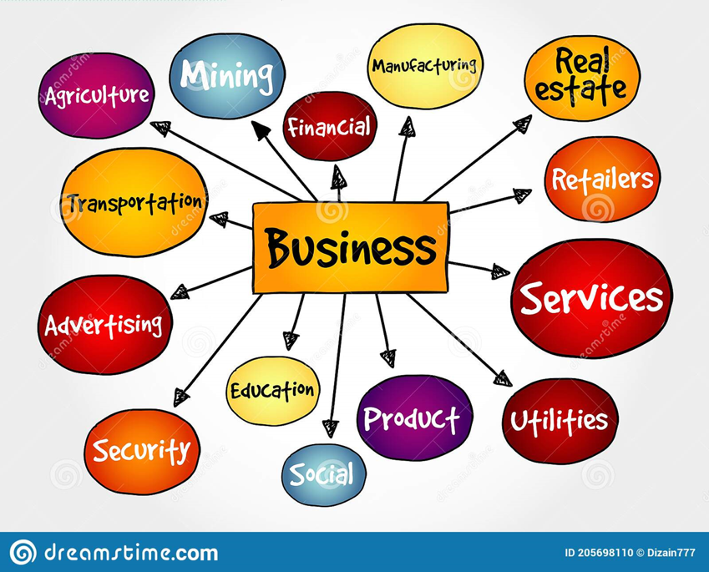
WHAT TYPES OF ENTREPRENEURS ARE IN YOUR COMMUNITY?
Boutiques
Restaurants
Small manufacturing
Artists and artisans
Education providers
Healthcare
Agribusinesses
Other examples?
Notes:
Allow FORWARD participants to brainstorm the actual entrepreneurs in their local community. This is also an opportunity for FORWARD participants to identify which of these businesses they would consider working for if the opportunity presented itself.

Slide 18

THE ROLE OF ENTREPRENEURSHIP AND SMALL BUSINESS
IN ECONOMIC DEVELOPMENT
Notes:
So far, we’ve looked at the impact of entrepreneurship on the national and state economy.
We’ve also examined how entrepreneurs are distributed across our state.
What does this mean within the context of economic development, specifically at the community level?
In this section, we will look at the role of entrepreneurship and small business in economic development.

Slide 19
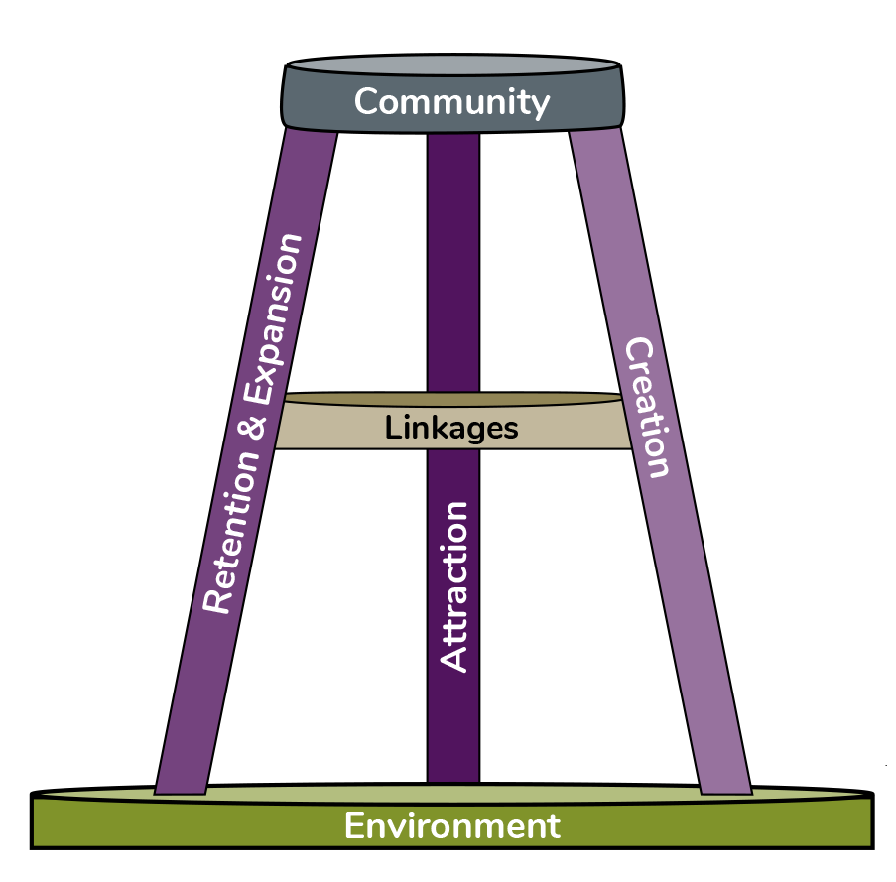
The Case for Entrepreneurship
The three-legged stool …
Represents three main ways that economic development professionals can promote economic vitality in their community
Often invoked to convey communities should take a balanced approach to economic development
Suggests entrepreneurship should also complement attraction, business retention, and expansion activities
Emphasizes how a community brings it all together!
Notes:
According to the literature, there are three main ways that economic development professionals can promote economic vitality in their community: recruitment, retention, expansion and creation, or entrepreneurship.
The “three-legged stool” is often invoked to convey that communities should take a balanced approach to economic development so the “stool” – representing your economy - is stable. This stabilization is strengthened if there are strong linkages between each of these approaches. In other words, entrepreneurship efforts should also serve to complement recruitment and business retention and expansion activities.
It is also important to note the community and environment play critical roles. All aspects of the economy are rooted in the environment (natural capital) in which they operate and contributes significantly to quality of life. Lastly, your community is what brings it all together. If your community is not supportive of economic development efforts, then the probability of success is very limited.

Slide 20
ENTREPRENEURSHIP AS AN ECONOMIC DEVELOPMENT STRATEGY
Starting points for policy…
Recruitment is an ineffective/limited strategy for many rural communities, except for those with particular locational attributes
Entrepreneurs and small businesses are the drivers of local and regional economies; represent appropriate scale of activity for rural places
Key working assumption – entrepreneurship should be included and play a key role in any comprehensive economic development plan
Notes:
Given this model, consider that for decades, the conventional wisdom for economic development has been that new economic activity has to be recruited from elsewhere rather than grown locally. A whole economic development industry has been created focused on marketing, recruitment and associated tax and other financial incentives.
This has led to escalating competition between counties, regions, and states to attract companies considering relocation or expansion, often at enormous cost to the “winning” area and a relatively lower probability of success.
There is another way (particularly for rural areas) – making entrepreneurship a fundamental economic development strategy. Entrepreneurs and small businesses are the drivers of local and regional economies and need to be recognized as such.
During our pilot phase of CREST, we found that this was a challenge in some counties. Adjusting a long term focus to include new or additional strategies can be a hard sell for some.

Slide 21
The Case for Entrepreneurship
The three-legged stool … from a workforce development perspective
Attraction strategies may bring workers from the previous location or create new opportunities for local people in the new location for the business
Business retention and expansion strategies aim to retain the current workforce and to attract from the local area where they are already located
Entrepreneurship is often overlooked as these businesses tend to be small and may not have employees
Notes:
From a workforce development perspective, attraction strategies may bring workers from the previous location or create
new opportunities for local people in the new location for the business. These firms often make decisions based on the
current workforce in the new area and prepare in-house training to overcome any potential deficits. Business retention
and expansion strategies aim to retain the current workforce and to recruit from the local area where they are already
located. This may require upskilling their current workforce or acting more like a new firm that has to attract and train
talent. Both of these economic development strategies involve established businesses and are familiar to economic
development professionals.
In contrast, economic development professionals often overlook the third leg, entrepreneurship. However, particularly
for rural areas, entrepreneurship needs to be a fundamental economic development strategy as entrepreneurs, and small
businesses are the drivers of local and regional economies. They also need to be explicitly incorporated into workforce
development strategies.

Slide 22
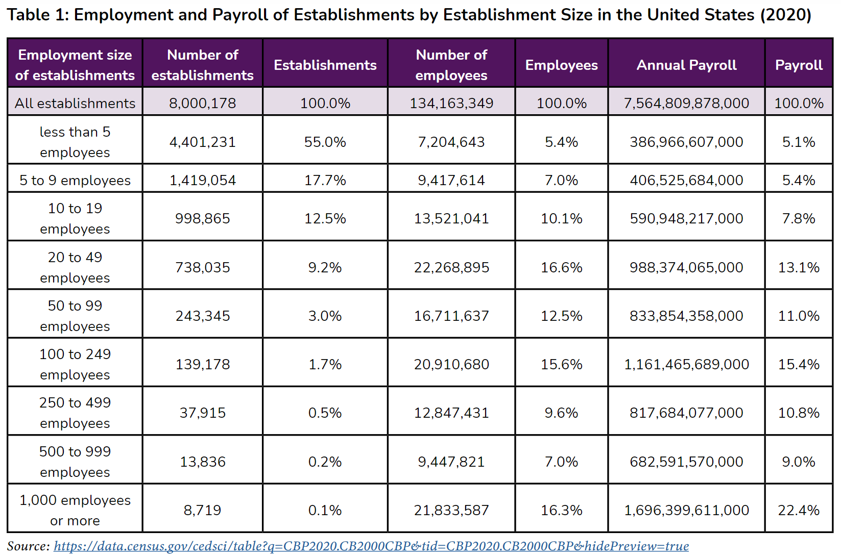
ENTREPRENEURSHIP AS A WORKFORCE DEVELOPMENT STRATEGY
Entrepreneurs and small business owners play an important role in the local economy and can serve as an important source of employment opportunities
Notes:
One way to recognize the importance of entrepreneurship is to examine the data.
Entrepreneurship classifications often invoke the number of employees (i.e. nonemployer firms, establishments with less
than five employees or 5 to 9 employees, etc.). In reality, entrepreneurs and their businesses come in all sorts of flavors –
including sector and firm size.
In the United States, over half (55%) of all business establishments have five or fewer employees, and eighty-five percent
have less than twenty employees (Table 1). These businesses account for an annual payroll of over $1.38 trillion dollars
and employ over thirty million people. Many of these establishments are located in rural areas. And, given these establishments’
location and size, not all will be equipped to attract and train employees solely on their own, creating a need
at the community or regional level for workforce development initiatives.

Slide 23
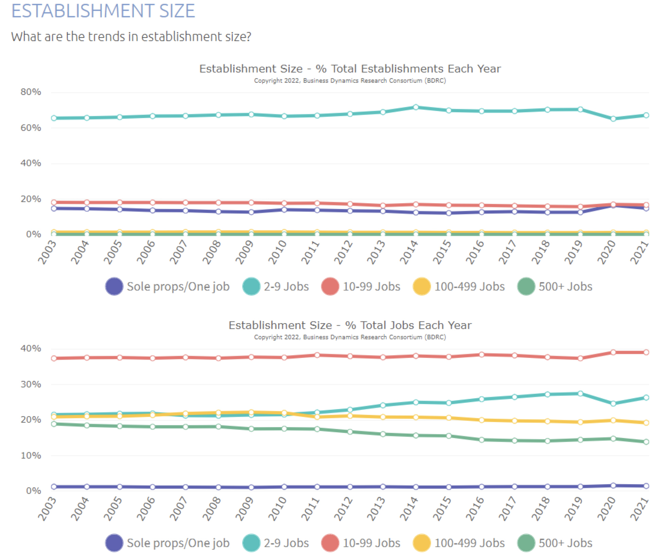
ENTREPRENEURSHIP AS A WORKFORCE DEVELOPMENT STRATEGY
Entrepreneurs and small business owners play an important role in the local economy and can serve as an important source of employment opportunities.
Figure: Establishment Size and Employment by Establishment Size in the United States (2021)
Notes:
While these numbers are impressive for the smallest of establishments, it should be noted that seventy-seven percent of
all employment in the United States is by establishments employing twenty or more employees. However, Figure 5 shows
that employment by establishments with 10-99 employees (along with 2-9 employees) occupy a larger share of employment
than the largest of establishments (100-499 and 500+).

Slide 24
ENTREPRENEURSHIP AS A WORKFORCE DEVELOPMENT STRATEGY
Entrepreneurs and small business owners play an important role in the local economy and can serve as an important source of employment opportunities.
Source: http://youreconomy.org/indexts.lasso?state=US&county=&msa=
Notes:
And the share of jobs by establishments with 10-99 employees (along with 2-9 employees) has been growing or remained steady since 2003 (versus declining for the larger establishments).
Also, it is important to remember that “establishments” differ from “firms.” The Bureau of Labor Statistics considers an establishment to be a “single physical location where one predominant activity occurs” versus a firm which can be an “establishment or a combination of establishments.” (BLS, 2016). This means that establishments are local, and their workforce development needs will need to be addressed locally.

Slide 25
ENTREPRENEURSHIP AS A COMMUNITY DEVELOPMENT STRATEGY
Large or small, numerous or few, the take-home message from this data needs to be clear. Entrepreneurs and small businesses play an important role in the local economy, including as:
EMPLOYERS: creating new jobs and playing a significant role in hiring part-time workers and new workforce entrants
TAX REVENUE GENERATORS: broadening tax base, thus generating greater property and income tax revenues
ECONOMIC SUPPORTERS: buying and supplying local products and services. Income generated typically not exported out of local community
PROPERTY OWNERS AND RENTERS: leasing space from local property owners and filling vacant storefronts downtown
PROVIDERS OF ECONOMIC STABILITY: small homegrown firms are, by definition, owned and operated by people who have a personal stake in the community and are more likely to remain
Notes:
Large or small, numerous or few, the take-home message from this data needs to be clear. Entrepreneurs and small
businesses play an important role in the local economy, including:
As Employers: creating new jobs and playing a significant role in hiring part-time workers and new workforce entrants
As Tax Revenue Generators: broadening the tax base, thus generating greater property and income tax revenues
As Economic Supporters: buying and supplying local products and services. Generating income that is typically not exported out of local comm
As Property Owners and Renters: leasing space from local property owners and filling vacant storefronts downtown
As Providers of Economic Stability: small homegrown firms are, by definition, owned and operated by people who have a personal stake in the community and are more likely to remain.

Slide 26

THE DNA OF AN ENTREPRENEUR (HBS, 2020)
  Curiosity
  Structured Experimentation
  Adaptability
  Decisiveness
  Team Building
  Risk Tolerance
  Comfortable with Failure
  Persistence
  Independent
  Risk Takers
Notes:
So, given what you know now about entrepreneurship, entrepreneurs and small business in your local community, now
is a good time to discuss how they are supported and what it will take to develop/strengthen an entrepreneurial career
pathway.
For starters, let’s think about the common characteristics of successful entrepreneurs. Harvard Business School has
identified ten, we can think of these as the “DNA” of an entrepreneur. These characteristics include:
1. Curiosity
2. Structured Experimentation
3. Adaptability
4. Decisiveness
5. Team Building
6. Risk Tolerance
7. Comfortable with Failure
8. Persistence
9. Independent
10. Risk Takers

Slide 27
THE DNA OF AN ENTREPRENEUR & WORKFORCE DEVELOPMENT
  Our challenge is to understand how to support entrepreneurs and help people learn how to work for entrepreneurs.
  The DNA characteristics might not capture the characteristics employers typically seek. This is why entrepreneurial career pathways are different!
  Potential employees need to balance their skills, experience and entrepreneurial know-how with that of the entrepreneur who has assumed the risk of starting this business and is trying to find employees that are a ‘good fit’ with their vision, passion, and goals.
Notes:
While the literature suggests that these are important for entrepreneurs, our challenge is to understand how to support
and work for such individuals. Certainly, when thinking about employees, this list of characteristics might not capture
the characteristics one typically seeks. This is why entrepreneurial career pathways are different, potential employees
need to balance their skills, experience and entrepreneurial know-how with that of the entrepreneur who has assumed
the risk of starting this business and trying to find employees that are a ‘good fit’ with their vision, passion and goals.

Slide 28
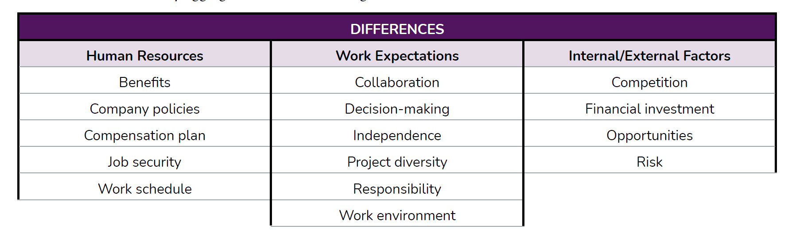
EMPLOYMENT VS. ENTREPRENEURSHIP (Indeed.com 2022)
Notes:
In the article, “Employment vs. Entrepreneurship: Similarities and Differences,” the editorial team at Indeed.com examines
how employment and entrepreneurship differ and some characteristics that these workforce opportunities share.
Differences can be loosely aggregated across three categories (see table on slide).
Differences may appear in schedule flexibility and whether one’s work effects the workplace or the marketplace.
Similarities may include aspects of payment, professional growth, work-life balance, client management, and
expectations.
At the end of the day, an entrepreneur carries all of the risk of owning the business. The employee of an entrepreneur
shares some of the burden of successfully representing the entrepreneur’s goods and services and effectively managing
relationships and aspects of the business under the leadership of the business owner. The importance of customer
service in the entrepreneurial career pathway cannot be over-emphasized, along with soft skills, intentional onboarding,
and continuous professional development so the employee of the entrepreneur/small business can provide the support
needed to make the business and the employee’s work experience successful.

Slide 29
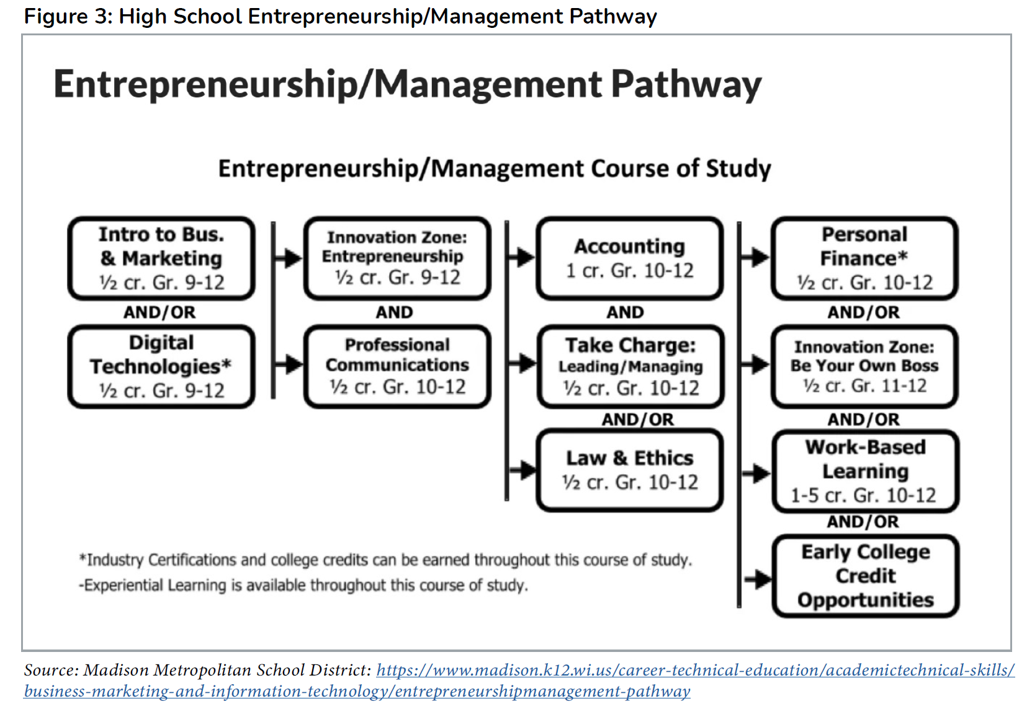
ENTREPRENEURSHIP CAREER PATHWAYS
Suppose that the case has been successfully made for your community to support entrepreneurship as a development strategy, now comes the process of informing the pathway.
Programs to consider:
Junior Achievement
Network for Teaching Entrepreneurship
YouthBiz
4-H’s ‘Be the “E”’
FFA’s Supervised Agricultural Experience
Notes:
Suppose there is a desire to build up entrepreneurship muscle in the region. In that case, it is worth identifying how to construct a pathway to equip employees with the skills necessary for them and their small businesses employer to succeed. The Madison Metropolitan School District (Wisconsin) provides one example of an entrepreneurship pathway constructed for high school students (Figure 3). While at the high school level, it provides insight into some of the training topics that could be relevant in the entrepreneurship space.
The pathway above is workforce development driven, addressing the skills and talent requirements of potential entrepreneurs and employees that may seek employment in the entrepreneurship sector. In practice, at the individual level, youth experience entrepreneurship through programs such as Junior Achievement, Network for Teaching Entrepreneurship, YouthBiz, 4-H's 'Be The "E"' and FFA's Supervised Agricultural Experience. These experiential learning opportunities allow youth to try on entrepreneurship and learn more about what it takes to conceive, conceptualize, prototype, test, evaluate, capitalize, launch and grow a business. From an economic development point of view, this process can result in job creation (oftentimes in the form of new 'nonemployer' businesses, so one business, one job), and the business owner bears all of the responsibility of making the business a success. However, from a workforce development perspective, these experiences prepare participants to work for an entrepreneur as much as it may lead to them starting a business.

Slide 30
ENTREPRENEURS & WORKFORCE DEVELOPMENT
NOTE: This would be a great opportunity to have one or two local entrepreneurs as guests to talk about their views on the DNA characteristics and the employment versus entrepreneurship difference and what they are looking for in employees.
It would be ideal if these were entrepreneurs looking to hire one of the program participants as a part of this training exercise (☺) or have experience with successfully hiring and managing staff.
Notes:
While the literature suggests that these are important for entrepreneurs, our challenge is to understand how to support
and work for such individuals. Certainly, when thinking about employees, this list of characteristics might not capture
the characteristics one typically seeks. This is why entrepreneurial career pathways are different, potential employees
need to balance their skills, experience and entrepreneurial know-how with that of the entrepreneur who has assumed
the risk of starting this business and trying to find employees that are a ‘good fit’ with their vision, passion and goals.

